Slide 1
When Technology and Systems Adapt to the Individual End User (people with cognitive disabilities)
Klaus Miesenberger
University of Linz, KI-I, Austria
Notes:
I changed to titel relatd to two aspects:
1) Techniques might be to general – I‘m computer scientist and I talk about technology
2) I will start with discussing how we

Slide 2
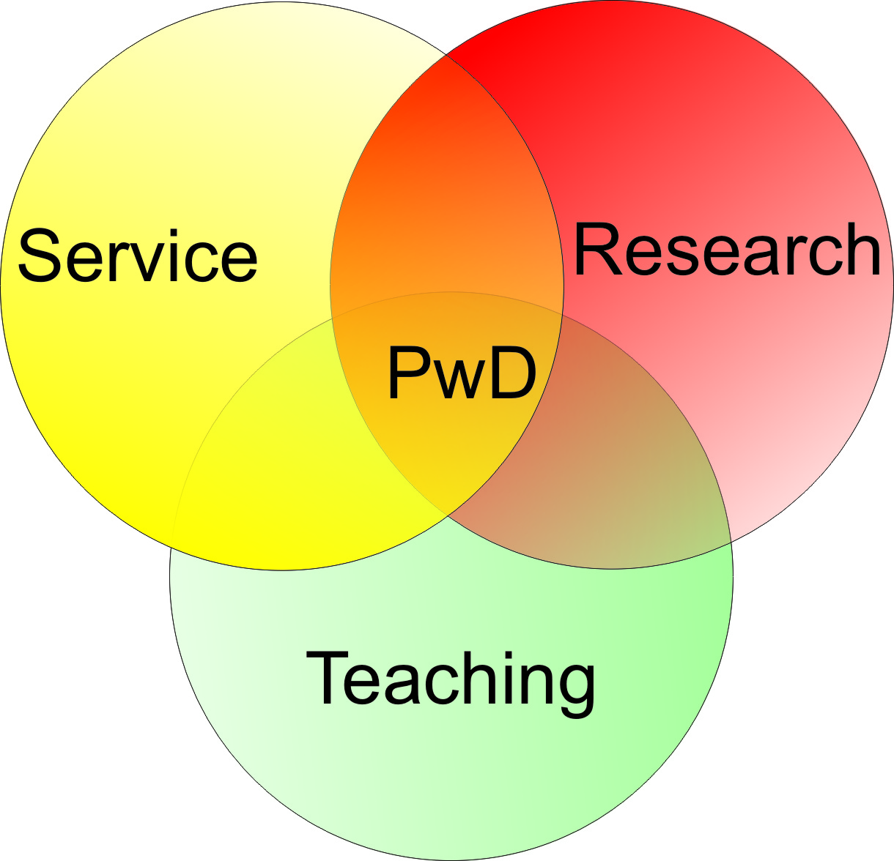
What we do
Research
Teaching
Service
Know-How Transfer
Notes:
Introduction: University and spinn-off KI-I what we do

Slide 3
I‘m a scientist
Notes:
We do the contrary of what is often needed:
Here we talk about how to describe complex things in an easy manner
Scientist tend to describe easy things in very complex words ….
So perhaps am the wrong person to present here.

Slide 4
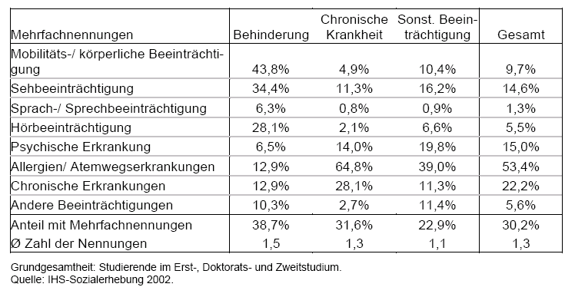
What we NOT (YET) do
People with Cognitive Disabilities
Statistics
Disability | Total (1000) | Total in % | <20 | 20-60 | >60
All (at least one) | 1.687 | 20,5 | 5,4 | 15,5 | 48,4
Vision | 318 | 3,9 | 1,2 | 2,2 | 10,8
Blind | 3
Hearing | 202 | 2,5 | 0,3 | 1,1 | 8,1
Deaf | 2
Speech | 63 | 0,8 | 0,7 | 0,6 | 1,5
Voiceless | 5
Mob/Motor | 1.070 | 13,0 | 1,1 | 9,9 | 32,6
Wheelchair | 50
Cognition/Learning | 85 | 1,0 | 1,2 | 0,7 | 1,9
Psychological | 205 | 2,5 | 0,7 | 2,5 | 4,4
other | 579 | 7,0 | 2,7 | 4,7 | 17,7
Multiple | 580 | 7,0 | 1,2 | 4,5 | 18,9
Notes:
Over the years it became clear: there is one group we do not address in the same way:
People with cognitive disabilities
This figure shows: not mentioned in Austrian statistics!

Slide 5
Yes, we are behind
Sweden: 5 – 8 % Learning Disabilities (Hjälpmedelsintstitutet)
University of Stockholm
34.000 students
36 hearing impaired / deaf
17 blind / low vision
43 motor disabilities
134 learning disabilities
…
University of Linz
17.000 students
5 hearing impaired / deaf
32 blind / low vision
27 motor disabilities
2 learning disabilities
…

Slide 6
Not only here: „The last group“

Slide 7
„What goes wrong“
“Talking about” but not with and by them
Lacking involvement
not generally consulted
no self-advocacy
under-represented
limited research
limited legislation / regulation on accessibility
limited research on impact of technology for user‘s quality of life
Notes:
Very much related to LANGUAGE
Any aspect excluding from language excludes from societal issues.

Slide 8
Our challenge
Consistent user involvement
service planning
research process
teaching content and style
Increase knowledge
users
accessibility
Technology
Evidence: Quality of Life
Human right, self advocacy
“Ownership” of ideas, projects, plans, goals, results …
Notes:
New methods are needed

Slide 9
Our challenge
Design
Quality of Life
Fun
Fashion
coolness factor
Aesthetics
COSTS
Mainstreaming Accessibility
Universal Design “but”
Accessibility “but”
Information
assessment/selection
instruction
training
ignorant environment
negative attitudes (parents, service providers, teacher, employer)
avoid stigmatization
frustration, abandonment, …
exclusion
“prescription”, not selection by user: AT to become part of service planning
Notes:
The need to change environment – out of traditional roles

Slide 10
Our resource
www.proqualis.at

Slide 11
Evaluation of the Quality of Services (housing, culture, education, job, …)
not about …
BY PEOPLE WITH COGNITIVE DISABILITIES
PEER EVALUATION
→ Contract with the Regional Government
Business contracts: Quality Consultants

Slide 12
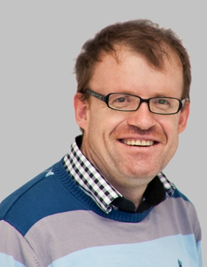
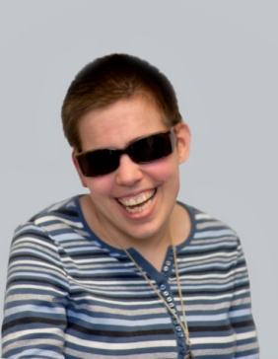
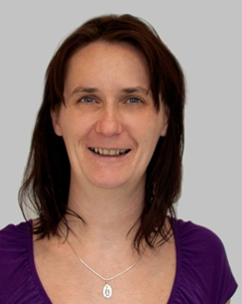
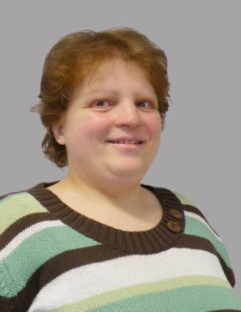
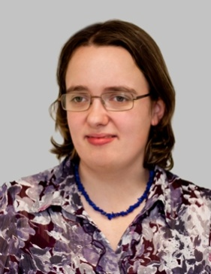
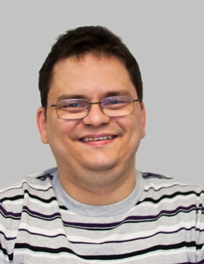
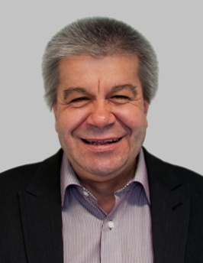
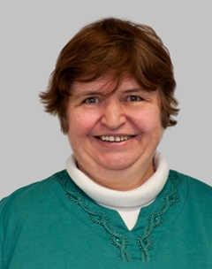
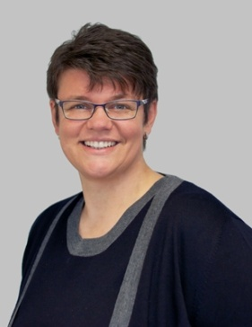
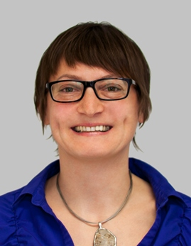
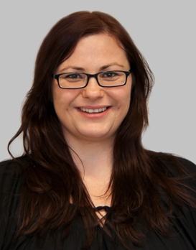
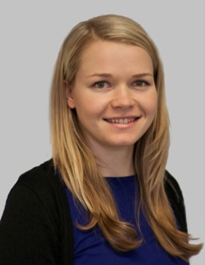
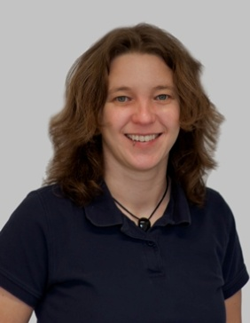
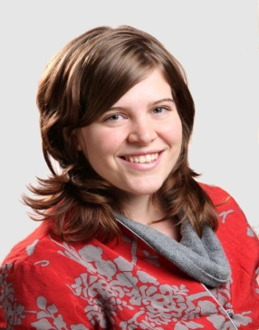
Danner
Johann
Kirchmayr
Antonia
Lackinger
Eva
Maurer
Christiane
Mitter
Franziska
Morwind
Rene
Mühlbachler
Karl
Pfeiffer
Cornelia
Peböck
Birgitt
Trautendorfer
Gabriele
Lattner
Karina
Lauss
Ulrike
Campbell
Margot
Karlinger
Myriam

Slide 13
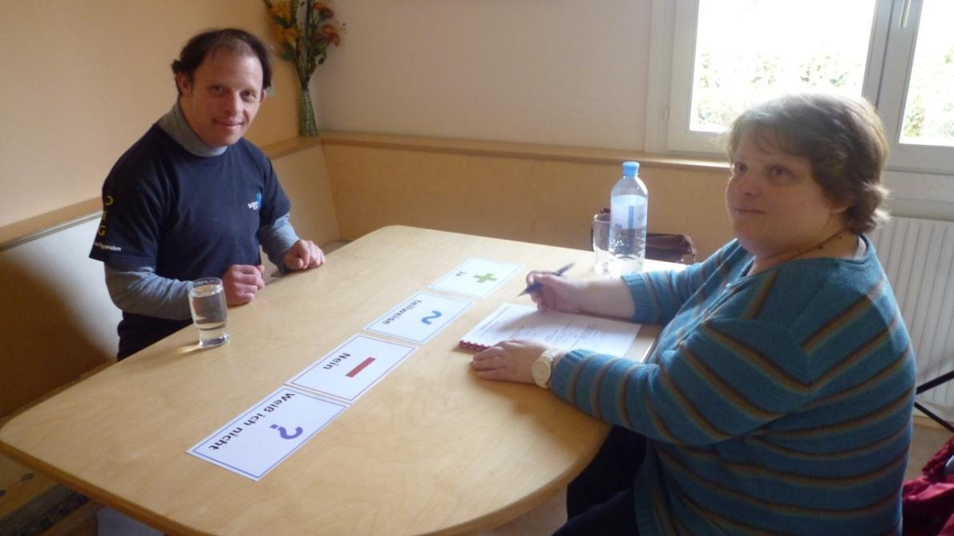
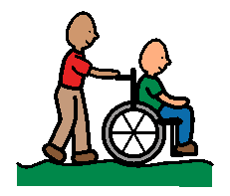
Staff
Evaluators trained for 2 years
Organization
Scientific and technical support
Ongoing education
Tools (co-developped)
Questionnaires (e2r, symbol language)
Analysis (statistical and qualitative)
Presentation

Slide 14
Easy to Read
Translation
Live Event Support
Teaching
Consulting

Slide 15
Research involvement: „Our ressource“
Ownership
Goals, projects
User needs
Guidance
Evaluation
…

Slide 16
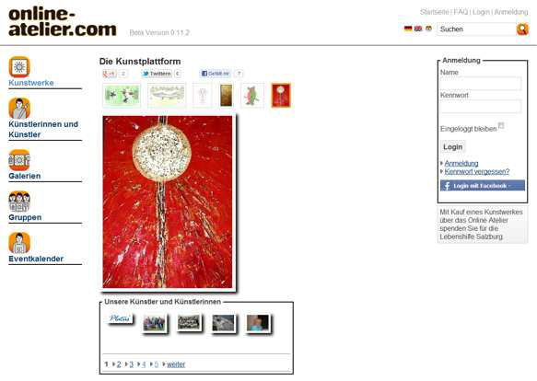
ICT/WEB
What die not work:
Working on “special interfaces”

Slide 17
ICT/WEB
What worked: “Wizzard”
Find out preferred settings through games and own selection
Which symbol size do users need?
Which font size?
Which design?
Can one read the text? Audio?
How well are symbols understood?
Preference regarding colored or black-and-white symbols
…

Slide 18
ICT/WEB
What worked: “Wizzard”
The mouse turn in a dog bowl and the user had to feed the dog. The dog and the dog bowl got smaller and smaller. There were 7 rounds and when they fail more than three times they symbol was the one before.

Slide 19
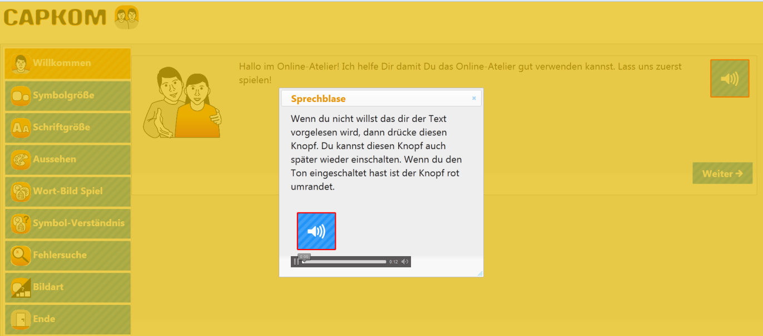
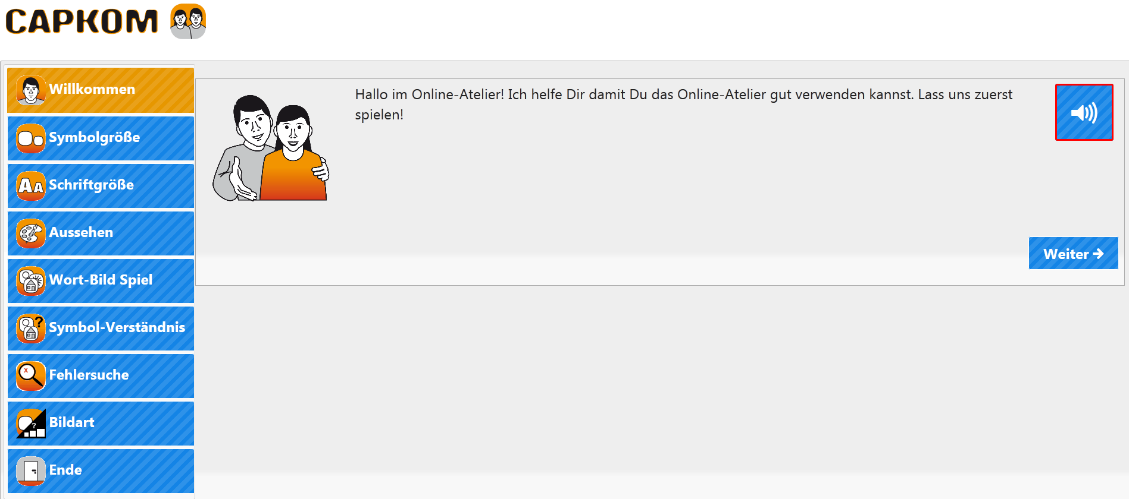
ICT/WEB
What worked: “Wizzard”

Slide 20
People want to be on the “same” pages
How?

Slide 21
People want to be on the “same” pages
Cognitive Screen Reader

Slide 22
Personal “buddy”
Invoking/Overlay to standard interface with
E2r
Text
Symbols
Speech
Sequencing
Animation/video
…
Conversion of structure / navigation
Annotation and use of synonyms / symbols (e.g. implemented as mouse over event)
Enrichment with pictures or videos / audio comments
Translation in Plain Language / Easy-to-Read
Text-to-Speech output with highlighting of read text
Implementation of avatars / wizards to support and develop individual abilities
Any user-defined combinations of the above measures

Slide 23
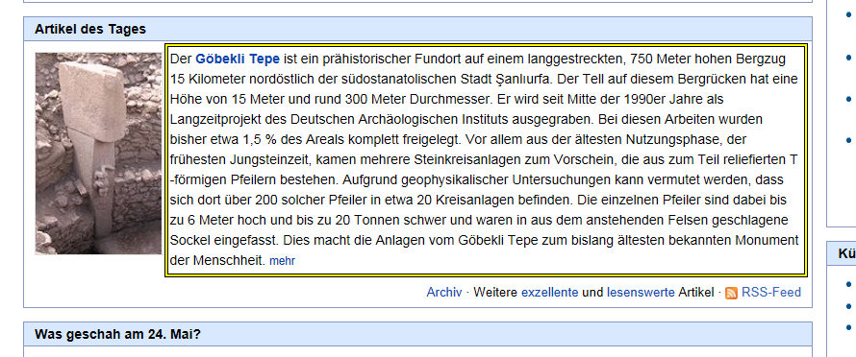
Personal “buddy”

Slide 24
Personal “buddy”
Presentation Layer
Query Interface, Query Result Presenter
Application Layer
“Reasoner”, Query Engine, Presentation Engine
Data/Web/Service Layer:
User Profile, e2r, OCR, Symbol translation, TTS, Restructurer, Sequencer
Allows to crowed source the approach: Any technical solution should be integrated into a known and used
USER EXPERIENCE – KEEP THE PRESENTATION LAYER!

Slide 25
Personal “buddy”
Documents
Web
Desktop
Phone
…
Cognitive Screen Reader

