Slide 1
Accessibility in the Digital Age:
The Unstoppable Impact of the Convention on the Rights of Persons with Disabilities
By Francesca Cesa Bianchi
Vice President, Institutional Relations, G3ict
FUNKA Accessibility Days, Stockholm, April 13-14, 2016

Slide 2
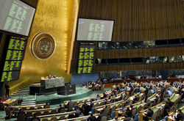
G3ict’s Global Purpose
History: Launched in December 2006 upon adoption of the Convention on the Rights of Persons with Disabilities (CRPD) by the United Nations General Assembly
Mission: To promote the accessibility of Information and Communication Technologies as per CRPD dispositions
Approach: In partnership with UN agencies, Disabled Persons Organizations (DPOs), National Governments, Industry, and Standards Development Organizations

Slide 3
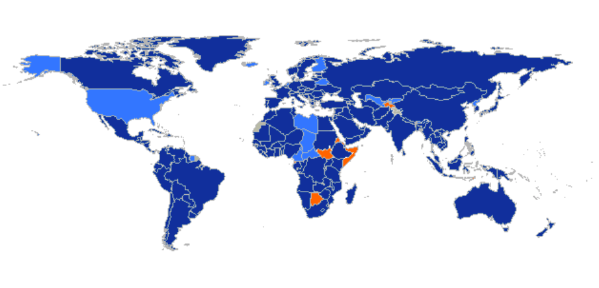
CRPD Facts & Figures 162 countries have signed the CRPD and 160 ratified as of April 2016
Notes:
Sweden: 30 Mar 2007 15 Dec 2008

Slide 4
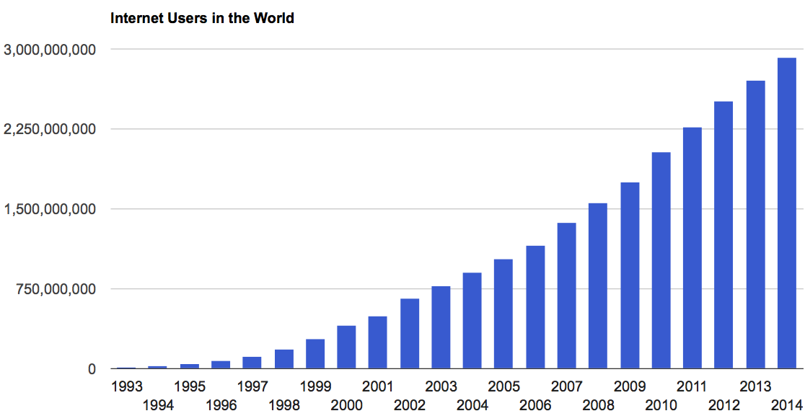
ICT Accessibility in the Digital Age: Prerequisite for Independent Living and Inclusion
7,500,000,000 mobile phones in service
3,300,000,000 Internet users
1,500,000 households with TVs

Slide 5
ICT Accessibility: An Extensive Set of Dispositions in the CRPD
Preamble – defines accessibility as an enabler for Persons with Disabilities to exercise their rights
Article 3 (f) – identifies Accessibility as one of its 8 general principles
- E.g. non-discrimination, equal opportunity, full participation in society, etc.
Article 9 - includes ICT in its definition of Accessibility & elevates ICT Accessibility obligations on par with those for the built environment and transportation
“Access/Accessible/Accessibility” 17 uses throughout the CRPD

Slide 6
Implications of CRPD for ICT Accessibility and Assistive Technologies Requirements
Application Areas | CRPD Articles | Accessibility Dispositions Applicable to ICTs | Reasonable Accommodation | Promoting Assistive Technologies
Non-discrimination | 5 |  | Y
E-Government | 9.2.a | Y
Media and Internet | 9.1, 9,2.g | Y
Television | 30.1.b | Y
Private Sector Services | 9.2.b | Y
Liberty and Security | 14 |  | Y
Living Independently | 19 |  |  | Y
Education | 24 | Y | Y | Y
Employment | 27 | Y | Y
Political Rights | 21, 29 | Y |  | Y
Emergency Services | 9.1.b, 11 | Y
Culture and Leisure | 30.5.c | Y
Personal Mobility | 20 |  |  | Y
Rehabilitation | 2 |  |  | Y

Slide 7
G3ict Advocacy Activities
Raising awareness of CRPD dispositions on ICT accessibility
Measuring Progress in implementation
Producing tools and resources to define and implement ICT accessibility policies
Organizing capacity building for policy makers and disabled persons organizations
Promoting ICT accessibility innovation
Facilitating global harmonization of ICT accessibility in public procurement

Slide 8
Raising Awareness of CRPD Dispositions
On-line resources:
60,000 annual unique visitors to G3ict web site
23,000 downloads & 12,000 annual unique visitors to the G3ict-ITU Policy Toolkit
Social media
New Accessibility Worldview global policy tracking service
In-country briefings and conferences:
Contributions to more than 150 international events
Briefings of country delegations at international events
Joint programs with United Nations agencies
ITU, UNESCO, ILO, OHCHR, UNDESA, UNITAR
Conference of States Parties to the CRPD

Slide 9
“If you can’t measure something, you can’t understand it. If you can’t understand it, you can’t control it. If you can’t control it, you can’t improve it.”
H. James Harrington
International performance improvement and quality guru

Slide 10
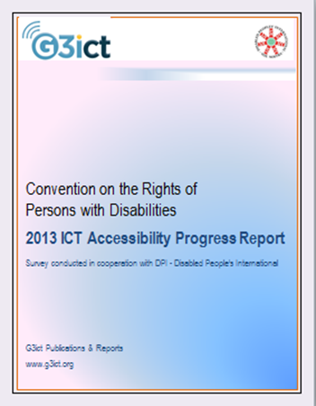
Measuring Progress in Implementation CRPD ICT Accessibility Progress Report
Systematic review of global progress on CRPD implementation
Survey conducted by G3ict with Disabled People’s International
2013 edition: 76 countries, 72% of the world population, 81% of the 139 CRPD ratifying countries (as of December 2013)
Regions and level of income evenly distributed
57 data points per country across 3 “legs”:
Country commitments
Capacity to implement
Actual results for persons with disabilities

Slide 11
CRPD Momentum: Considerable Impact on Country Legislations and Government Focus
85% of countries surveyed have a constitutional article, law or regulation defining the rights of persons with disabilities
69% of countries surveyed have a designated focal point within government for matters relating to the CRPD and a framework for implementing and monitoring the CRPD
62% of countries surveyed have a definition of "Reasonable Accommodation“ included in a law or regulation (this was only mentioned in very few countries before the adoption of the CRPD)

Slide 12
Legal Foundation of ICT Accessibility Adopted by More Countries
50% of surveyed countries have a definition of accessibility which includes ICTs or electronic media in the country laws or regulations
Up from 31% in previous report in 2012
Critical legal foundation for in-country ICT accessibility advocacy, policy and regulatory activities

Slide 13
However, Significant Policy Gaps Remain: Accessibility of Information Infrastructure
Policies Covering Specific ICT Products & Services | No Policy | Minimum | Partial | Substan-tial | Full
Wireless Telephony | 61% | 18% | 13% | 4% | 4%
Web Sites | 51% | 30% | 12% | 7% | 0%
Television | 28% | 50% | 16% | 6% | 0%

Slide 14
Policy Gaps - Assistive Technologies and Reasonable Accommodation
AT & Reasonable Accommodation Policies in Specific Application Areas | No Policy | Minimum | Partial | Substantial | Full
Voting Systems | 59% | 12% | 19% | 8% | 1%
Primary & Secondary Education | 41% | 23% | 25% | 11% | 0%
Higher Education | 49% | 22% | 22% | 7% | 0%
Workplace | 44% | 26% | 19% | 11% | 0%

Slide 15
Overall, Countries Results Are Lagging Due to Inadequate Capacity to Implement

Slide 16
Critical Gaps in Capacity to Implement

Slide 17
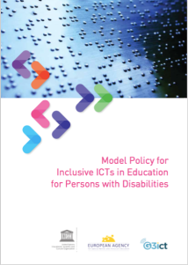
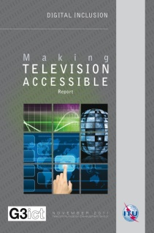
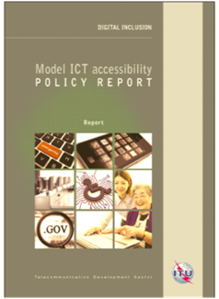

Publications and Reports
Model policies for States Parties with UNESCO and ITU http://g3ict.com/resource_center/G3ict_Publications
Inclusive ICTs for Education (With UNESCO)- March 2014
Legal framework, TV, Mobile, Web, Public Procurement, Public Access Points (With ITU) – November 2014
Technical reports (TV, Mobile, USF) & good practices
E-Accessibility Policy Toolkit for Persons with Disabilities www.e-accessibilitytoolkit.org
G3ict web site resource center www.g3ict.org

Slide 18
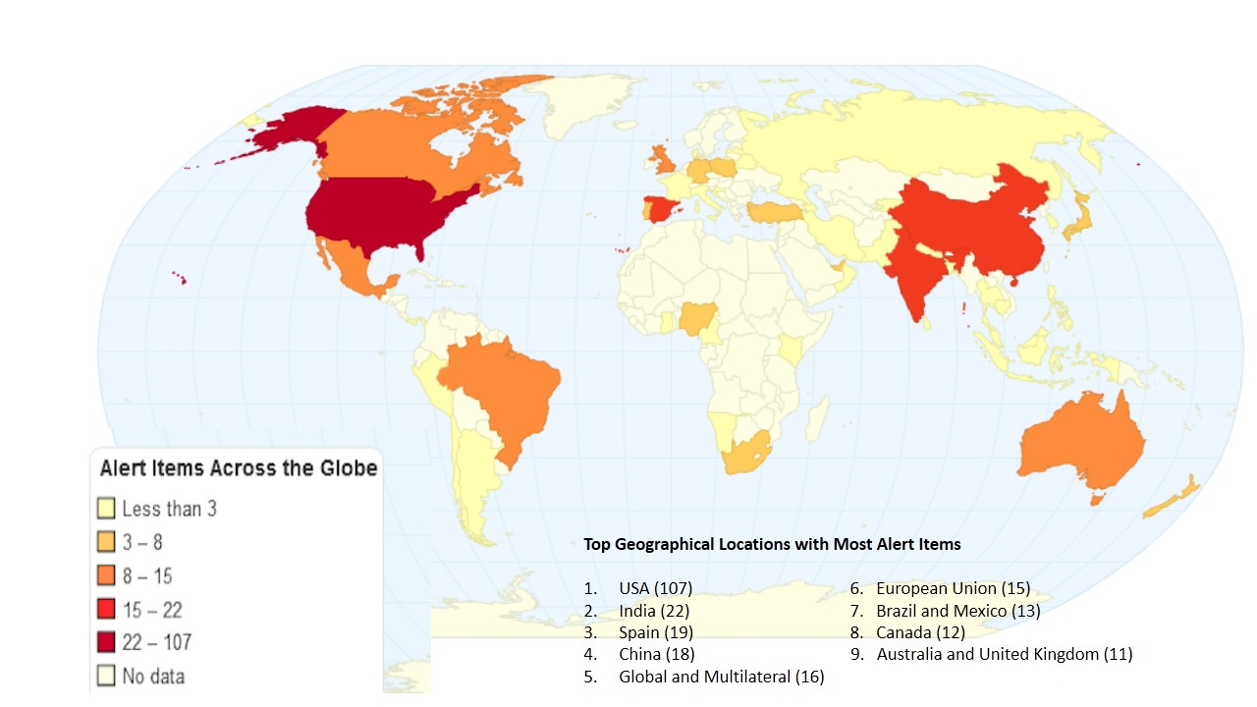
Additional G3ict Research: Continuous Tracking of Global Policy Hot Spots with Dow Jones Factiva Worldview Service for G3ict Participating Organizations - One million + Stories Filtered Daily and Curated with Custom Analysis

Slide 19
Recent In-Country G3ict Capacity Building Programs and Seminars
2015 - 2016:
Brazil
Colombia
India
France
Mexico
Morocco
Pakistan
Russia
South Africa
Sri Lanka
United States
Turkey

Slide 20
In-Country Cooperation between G3ict, Governments and Local Stakeholders
Example of Turkey:
Confederation of Persons with Disabilities
Ministry of Family and Social Affairs: Lead CRPD Government Agency
BTK: Telecom Regulator overseeing information infrastructure
National Agency for Public Procurement
Ministry of Education
Istanbul Chamber of Commerce ICT Sector
Mobile and cable operators
G3ict in-country activities aim to foster multi-stakeholder cooperation and awareness of solutions and model policies

Slide 21

M-Enabling Summit: G3ict’s Annual Global Forum In Cooperation with ITU and the FCC
Largest global dialogue on accessibility among mobile stakeholders:
Mobile industry, innovators, policy makers, disability advocates, CIOs from 30+ countries
Promotes innovation and showcases solutions that work
500 to 600 participants, Washington, D.C.
Internet of Things, Assistive Services, Smart Cities solutions, Inclusive Higher Education, Scaling up accessibility in large organizations
Next edition June 13-14, 2016

Slide 22
public procurement
G3ict Global Charter

Slide 23
Public Procurement Policies to
Drive Accessibility
Key to influence markets & companies
Government purchases of goods and services account for 10-15% of a country’s GDP, 16% in EU, 25% of ICT purchases in USA
National gov’t is usually largest single customer for most ICT companies
Focus ICT vendors on accessibility - drive innovation & competition
Develop local accessibility ecosystem, capacity, and expertise
Lower costs though harmonized standards & competition
Benefits all Persons with Disabilities
Accessible e-government and improved public sector employment rates
Key to many policy objectives, e.g. inclusive education, accessible voting, etc.
Required by the CRPD – Articles 4, 9, 35
ICT Accessibility in procurement policies implemented in just 33% of countries
Notes:
Policy Activity: US & EU leadership with Section 508 (USA), EN 301 549 & Revised Procurement Directive (EU)

Slide 24
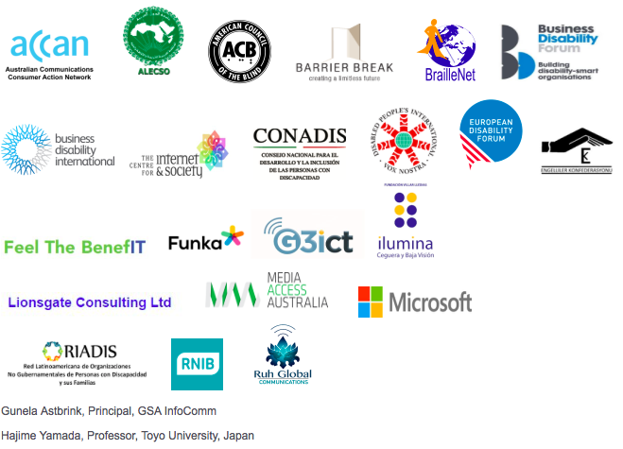
G3ict Procurement Charter Early Signatories
To sign the Charter: http://g3ict.org/resource_center/g3ict_global_charter

Slide 25

Thank You for your Attention!
www.g3ict.org
www.e-accessibilitytoolkit.org
www.m-enabling.com
fcesabianchi@g3ict.org
Thank You
For Your Attention!
www.g3ict.org
www.e-accessibilitytoolkit.org
www.m-enabling.com
axel_leblois@g3ict.org
Notes:
25

