Slide 1
Building A Workplace Accessibility Ecosystem
Funka | Accessibility Days 2018

Slide 2
Presentation Overview
Employment Inclusion Data Outcomes Survey
Internal Inclusion Accessibility Efforts
Employment Tracker Results Survey
Choosing a Framework
Problems and Solutions
Data Collection
Strategy & Metrics
Culture & Climate
Accommodations
ICT Workplace Accessibility
Resources

Slide 3
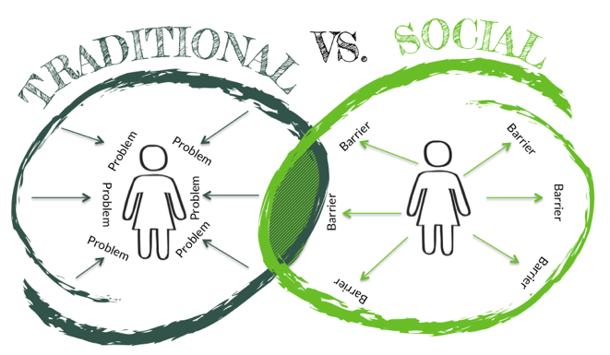
The Social Model of Disability
The origins of the approach can be traced to the 1960s; the specific term emerged from the United Kingdom in the 1980s.
The social model of disability is a reaction to the dominant medical model of disability.
The social model of disability identifies systemic barriers, negative attitudes and exclusion by society.
Society is the main contributory factor in disabling people.

Slide 4
Job Accommodation Network | Direct Benefits Accommodation and Compliance Series Workplace Accommodations: Low Cost, High Impact
Accommodating Employees
Direct Benefits
Retaining qualified employees
Increase workers productivity
Accommodations eliminated the cost of training new employees

Slide 5
Job Accommodation Network | Indirect Benefits Accommodation and Compliance Series Workplace Accommodations: Low Cost, High Impact
Accommodating Employees
Indirect Benefits
Accommodation ultimately improved interactions with co-workers
Increased company morale
Increased company productivity

Slide 6
Accommodations
Individual Employee Profile
Lessons learned
Consideration factors
AT evaluation
Policies, procedures, and IT infrastructure
Job duties and task
Accommodations
Type
Cost

Slide 7
Booz Allen Hamilton Workplace Adjustment Team
Ann Hinson
13 years at the firm
Increasing number of spelling, grammar and syntax mistakes
Diagnoses of dyslexia, a language-processing disorder
Technology tools that help improve her writing and reading comprehension.
Still on the job
"I really didn’t like to tell people that I have dyslexia," Hinson says.”
"It’s only just recently that I felt comfortable enough to tell my manager.”
The technology tools "gave me confidence”

Slide 8
2016 Survey National Organization on Disability (NOD)
Disability Employment Tracking
175 + companies responding
10.1 million workers
Workforce size
1,000 or less (5%)
1,000 – 10,000 (23%)
10,000 – 50,000 (44%)
50,000 (28%)

Slide 9
NOD | 2016 Survey Employment Tracker Results
20-point improvement in the rate of recruiters being trained on disability employment needs (65% vs. 44% in 2014).
85% of 2016 respondents have a diversity champion (up from 76% in 2014).
Disability still lags behind general diversity initiatives in many areas. Employees with disabilities (58%) vs. other diversity groups (78%).

Slide 10
NOD | 2016 Survey Disability Inclusion Skills Accountability
Manager and employee performance reviews, are not being used to drive accountability for developing disability inclusion skills.
Manager performance reviews including disability (25%)
Employee performance reviews including disability (18%)

Slide 11
Centralized. Problems. Solutions.
Building a Workplace Accessibility Framework

Slide 12
Choosing a Framework and Home
Specific Factors
Structure Options
Size
Existing Organizational Structure
Nature of IT purpose (development and sales of products/services versus public service)
Testing and quality assurance
Separate departments within the centralized accessibility area
Integrated as a single multidisciplinary department

Slide 13
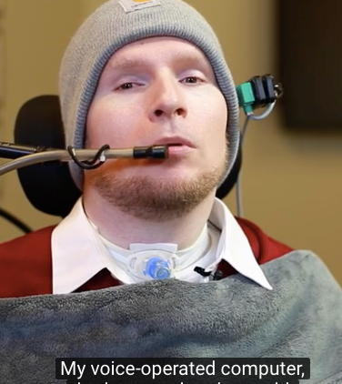
Inclusion Strategies Factors
Executive support
Promote inclusion
Roadmap and timeline
Diversity champion accountability to drive disability strategy
Exposure and education

Slide 14
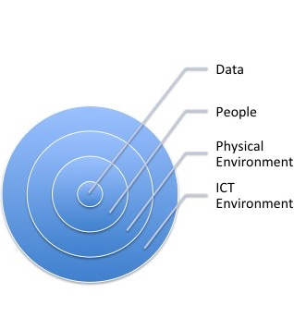
Data Collection
Organization & employee application
Tracking, analyzing & reporting
Informed discussion

Slide 15
Resources
Workplace Accessibility Framework Components

Slide 16
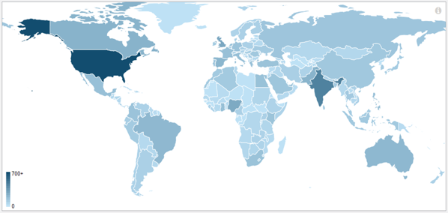
Accessibility Training Resource Workplace Framework Component
ICT Accessibility Employment MOOC
Foundations of ICT accessibility
Principles of accessible ICT design.
Identify the uses of assistive technology.
Create accessible documents and multimedia.
Evaluate and repair websites for accessibility.
Identify components of ICT accessibility operations.
Participants
7,636 enrollment
161 countries
United States (25% enrollment)
India (10% enrollment)
Nigeria (4% enrollment)

Slide 17
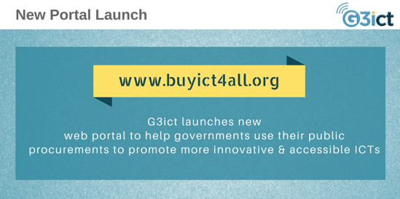
Procurement
Ensure consistent implementation of procurement procedures
Develop an organizational strategy for selection of ICT products/services to be evaluated for conformance with accessibility standards
Coordinate with ICT vendors to resolve issues with accessibility support or documentation
Participate in the testing and evaluation
Ensure organization procurement knowledge transfer

Slide 18
Organizational Resources
Developing a Web Accessibility protocol (WC3)
National Organization on Disability (NOD), Disability Employment Tracker
The International Association of Accessibility Professionals (IAAP)
The Global Initiative for Inclusive Information and Communication Technologies (G3ict)
AccessGA, Supporting State agencies with ICT accessibility
Web Accessibility Group (WAG)

Slide 19
Building A Workplace Accessibility Ecosystem
Funka | Accessibility Days 2018 |Final Slide

