Slide 1
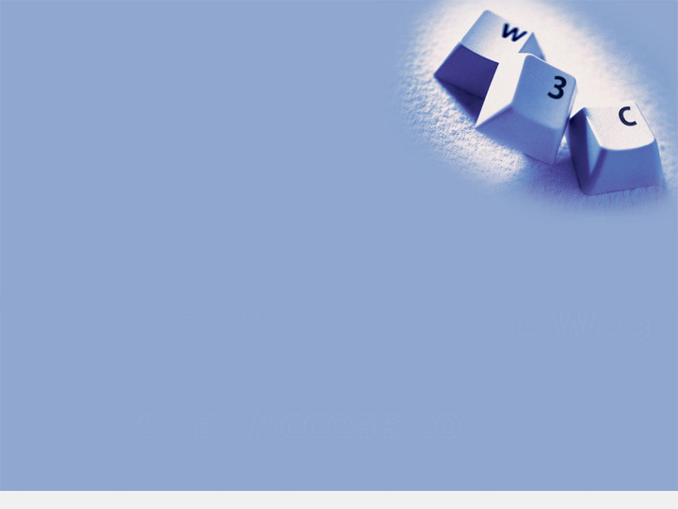
Web Accessibility:
Looking into the Future
Shadi Abou-Zahra
World Wide Web Consortium (W3C)
http://www.w3.org/People/shadi/
Copyright © 2018 W3C (MIT, ERCIM, Keio, Beihang)
Notes:
My name is Shadi Abou-Zahra.
I’m the W3C Accessibility Strategy and Technology Specialist.
Today’s talk on Web Accessibility, Looking into the Future, will take you through a tour of different efforts currently going on at W3C, and what we need to work on today to address accessibility in the Web of tomorrow. Technology is fast evolving and the future is closer than we often think it is.

Slide 2
About W3C
World Wide Web Consortium (W3C):
Founded by Sir Tim Berners-Lee in 1994
International, vendor-neutral consortium
Multi-stakeholder, consensus process
Develops royalty-free web standards:
HTML, CSS, XML, SVG, SMIL, ...
Hosted MIT, ERCIM, Keio, and Beihang
Copyright © 2018 W3C (MIT, ERCIM, Keio, Beihang)
Notes:
First, some background about W3C – the World Wide Web Consortium.
W3C was founded in 1994 by Sir Tim Berners-Lee, inventor of the World Wide Web.
It is an international, vendor-neutral consortium with currently nearly 500 Member organizations from around the world.
These members represent different stakeholders, including industry, research, academia, government, user representation, and others, who collaborate in an open, consensus-based process, to develop core standards of the Web. These are provided royalty-free for anyone to use, and include HTML, CSS, XML, SVG, and many more.
Operationally W3C is hosted by MIT in the United States, ERCIM in France/Europe, Keio Institute in Japan, and Beihang University in China.

Slide 3
About WAI
W3C Web Accessibility Initiative (WAI):
Ensures accessibility support in W3C technologies
Evolves guidelines for accessibility implementation
Develops methods for conformance evaluation
Develops resources for education and outreach
Coordinates with research and development
Pursues standards coordination and harmonization
Copyright © 2018 W3C (MIT, ERCIM, Keio, Beihang)
Notes:
Part of the W3C is the Web Accessibility Initiative – WAI – which develops strategies, resources, and guidelines to make the web accessible for people with disabilities.
This comprises several areas of work, including:
Ensuring accessibility support within W3C technologies, such as the alt-attribute in HTML and other accessibility features;
Evolving guidelines to support the implementation of web accessibility, which we will look at more closely later on;
Developing methods for conformance evaluation of accessibility, which we ill also look at more closely later on;
Developing resources for education and outreach, especially since lack of awareness and skills continue to be critical factors for accessibility implementation;
Coordinating with research and development, especially since accessibility is typically at the forefront of technological adoption; and,
Pursuing standards coordination and harmonization, because an enlarged and stronger market accelerates accessibility implementation.

Slide 4
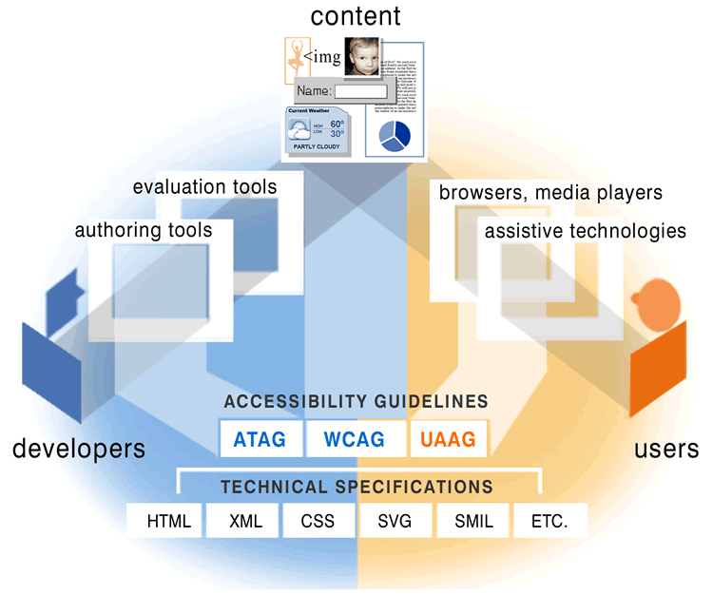
WAI Components
Copyright © 2018 W3C (MIT, ERCIM, Keio, Beihang)
Notes:
Illustratively these efforts of the W3C Web Accessibility Initiative (WAI) map to different components of web accessibility:
At the bottom of the illustration are the core technical specifications of the Web, such as HTML, XML, CSS, SVG, SMIL, and others. WAI ensures accessibility support within these core web technologies, and in some cases develop additional solutions such as WAI-ARIA, which we will look at later on;
On top of these technical specifications are the accessibility guidelines ATAG, WCAG, and UAAG, which we will look at in more detail in the next slide;
From the left, developers use authoring tools and ideally also evaluation tools to create accessible web content – ATAG is relevant in this context;
From the right, users use browsers, media players, and sometimes also assistive technologies to access the web content – UAAG is relevant here;
On the top-most center is the content, which includes text, images, forms, and more – WCAG is relevant in this context.
These essential components of web accessibility are further described in the WAI resource: https://www.w3.org/WAI/intro/components.php

Slide 5
WAI Guidelines
Web Content Accessibility Guidelines (WCAG)
Text, forms, graphics, videos, sounds, code, ...
Authoring Tool Accessibility Guidelines (ATAG)
Content Management Systems CMS, editors, ...
User Agent Accessibility Guidelines (UAAG)
Browsers, media players, and other applications
Copyright © 2018 W3C (MIT, ERCIM, Keio, Beihang)
Notes:
Looking at the WAI-Guidelines, there are actually three:
W3C Web Content Accessibility Guidelines (WCAG), which is the most widely known, defines accessibility requirements for all web content, including text, forms, graphics, videos, sounds, code, and more. In particular, it includes dynamic and mobile websites and applications.
W3C Authoring Tool Accessibility Guidelines (ATAG) is in my view equally important. It defines accessibility requirements for content management systems, code editors, and other software used to create web content. It is essential to achieving and maintaining accessibility.
W3C User Agent Accessibility Guidelines (UAAG) defines accessibility requirements for web browsers, media players, and other applications that render web content to the end user. This could include some types of assistive technologies but equally mobile applications.
Together these three specifications define end-to-end accessibility, from its creation by the developer all the way to the end-user.

Slide 6
W3C Process
Working Draft
Wide Review (Last Call)
Candidate Recommendation
Proposed Recommendation
W3C Recommendation (Web Standard)
Copyright © 2018 W3C (MIT, ERCIM, Keio, Beihang)
Notes:
All WAI work is carried out under the W3C Process, which defines roles and responsibilities, as well as the maturity model for W3C specifications. Currently WCAG and ATAG are W3C web standards, which follow a rigorous process with several development stages. Simplified, these are:
Working Draft – typically a W3C Working Group develops several draft iterations. Currently most of these drafts are developed open via GitHub, a collaboration platform. The working group publishes snapshots for review at regular intervals to mature the specification.
Wide Review (Last Call) – when the W3C Working Group believes it has addressed all comments and has a mature specification that is ready for implementation, it can announce a wide review draft for (hopefully) final comments.
Candidate Recommendation – when all comments are processed, the features are frozen and the W3C Working Group needs to demonstrate that these features can be implemented in practice. Typically this means two independent implementation for each feature.
Proposed Recommendation – is the final stage where the W3C Member organization have a final change for review before the specification is formally finalized.
W3C Recommendation – is the term used to denote a formally finalized W3C Web Standard, which is approved by the Working Group and the membership.
At any of these stages the specification may iterate, or may even fall back to lower maturity levels depending on the comments received. For example, a comment may identify a major design flaw, in which case the specification may need to be significantly revised. Currently WCAG 2.1 is closing the “Candidate Recommendation” stage.

Slide 7
WCAG 2.0
W3C Recommendation (December 2008):
Perceivable, Operable, Understandable, Robust
12 Guidelines, 61 Success Criteria, 3 Levels
Adopted as ISO 40500, JIS 8341, UNE 139803
Included in EN 301 549, Section 508 standard
Referenced in laws and policies internationally:
w3.org/WAI/Policy/
Copyright © 2018 W3C (MIT, ERCIM, Keio, Beihang)
Notes:
WCAG 2.0, however, remains the stable and operational version. It was published in December 2008, and is a milestone achievement.
WCAG 2.0 is designed around four core “Principles”:
Perceivable: to allow people to perceive content visually, through audio, or through tactile, as needed;
Operable: to allow people to interact with content in different modalities, such as keyboard, mouse, and more;
Understandable: to allow people to comprehend the content, such as text that is easier to read;
Robust: to ensure that the content works properly for people using different assistive technologies.
WCAG 2.0 is recognized internationally by many governments and businesses as the standard for web accessibility. WCAG 2.0 is available as ISO 40500. It has also been adopted in the Japanese standard JIS 8341 and the Spanish standard UNE 139803. Beyond that, it has also been included directly in the European standard EN 301 549, and reference in the technical specifications of the US Section 508 law. It is also referenced in many laws and policies around the world, as outline in: w3.org/WAI/Policy/

Slide 8
WCAG 2.1
W3C Candidate Recommendation:
Fully backwards compatible with WCAG 2.0
Improvements for people with cognitive and learning disabilities, low vision, and on mobile
Currently includes 17 new Success Criteria
Scheduled for final completion in June 2018
Copyright © 2018 W3C (MIT, ERCIM, Keio, Beihang)
Notes:
WCAG 2.1 will be further introduced in later presentations today. As said, currently it is still in development, even though it is becoming rather mature.
WCAG 2.1 will not replace WCAG 2.0. They will co-exist. In fact, WCAG 2.1 will be fully backwards compatible with WCAG 2.0. It is up to policies as to when they will adopt 2.1.
The motivation for WCAG 2.1 was to address known issues in the areas of people with cognitive and learning disabilities, people with low vision, and people using mobile devices. These aspects were specifically researched through dedicated Task Forces, and proposals for new Success Criteria were made.
Not all Success Criteria passed the requirements of being broadly applicable, testable, and implementable. Currently 17 new Success Criteria are included in the WCAG 2.1 draft, of which 3 are marked “At Risk”, which means that they could also be dropped in the upcoming development stage.
Many of these Success Criteria are related to existing ones. However, since existing Success Criteria are not changed to ensure backward compatibility, the new requirements needed to be formulated as separate Success Criteria.

Slide 9
Technical Support
Technical resources (selected):
Understanding WCAG 2
Techniques for WCAG 2
How to Meet WCAG 2 (quick reference):
w3.org/WAI/WCAG20/quickref/
Copyright © 2018 W3C (MIT, ERCIM, Keio, Beihang)
Notes:
Around WCAG 2.x there are very useful supporting materials. These include:
Understanding WCAG 2, which explain the background and provide additional information to each Success Criteria;
Techniques for WCAG 2, document known ways of meeting Success Criteria as well as known best practices;
How to Meet WCAG 2 (quick reference), which combines all these resources into an interactive developer tool.
In my view there is a lot of untapped potential to provide additional guidance, and often untapped potential for developers to make use of these existing resources. For example, many more best practices could be documented as authoritative guidance from the Working Group.

Slide 10
Educational Support
Educational resources (selected):
Getting Started Tips
Web Accessibility Tutorials
Web Accessibility Perspectives (videos):
w3.org/WAI/perspectives/
Copyright © 2018 W3C (MIT, ERCIM, Keio, Beihang)
Notes:
WAI also provides many educational resources around the WAI Guidelines and technical solutions, to help leverage the skills of designers and developers. For example, the Getting Started Tips resource provides an easy entry in a role-based approach to accessibility, rather than the guidelines-based approach of the standard. The Web Accessibility Tutorial provide more in-depth guidance of particular topics which are commonly a source of barrier on the Web. I would love to see more of these. Also more videos. Currently the Web Accessibility Perspectives provides a series of 10 short videos (under 1 minute each), to explain particular accessibility features. From there you can find several links to related resources, including to related Getting Started Tips and Web Accessibility Tutorials.

Slide 11
WAI-ARIA 1.1
Accessible Rich Internet Applications (WAI-ARIA), W3C Recommendation (December 2017):
Improvements for static tables model, news feeds, modal dialog boxes, labeling, extended descriptions, keyboard shortcuts, and custom role types
New digital publishing module and API mappings
Revised WAI-ARIA Authoring Practices guidance
Copyright © 2018 W3C (MIT, ERCIM, Keio, Beihang)
Notes:
As said earlier, the WAI Guidelines is only part of the picture. Equally important is ensuring accessibility support within the core web technologies. In some cases it is necessary to develop specific solution to support accessibility requirements. The WAI Accessible Rich Internet Applications (WAI-ARIA) was developed at the time when the web was becoming increasingly dynamic and HTML4 had no intrinsic concept for that. WAI-ARIA defines a taxonomy for roles and properties, for example to define a role “button” with the value “pressed”. Such information could be communicated to assistive technologies, irrespective of the visual presentation and behavior of the object. Meanwhile HTML5 supports most WAI-ARIA roles natively. However, it is still important in several situations, such as custom controls, and for technologies such as SVG. An updated WAI-ARIA 1.1 was published in December 2017 with several improvements. Most of all, it addresses Digital Publishing through the ePub standard.

Slide 12
Personalization
Personalization Semantics Content Module 1.0, W3C Working Draft (February 2018):
Standard terms to identify the different objects
Enables user-driven personalization of content
Allows association of symbols with the objects
Copyright © 2018 W3C (MIT, ERCIM, Keio, Beihang)
Notes:
A very new work item is Personalization Semantics Content Module 1.0, which is still at Working Draft stage. This defines terms for different objects, so that they can be recognized and personalized by assistive technology. For example, to use a consistent icon for the search, send, or purchase buttons on forms. There is still a lot of discussion on how this would work in practice. However, this is very interesting work with lots of potential for content adaptation.

Slide 13
Conformance Testing
W3C Accessibility Conformance Testing (ACT):
Consistent “rules” for tools and methodologies
Automated, semi-automated, and manual rules
Openly developed through community process
Gradually increase tools support for evaluation
w3c.github.io/wcag-act-rules/
Copyright © 2018 W3C (MIT, ERCIM, Keio, Beihang)
Notes:
Finally, among many other efforts there is currently also a lot of work on Accessibility Conformance Testing – ACT. This worked emerged from long history of attempts in trying to harmonize testing approaches. It seems that there is now sufficient critical mass behind this effort, and there is (for me!) very exciting progress.
The objective is to develop “rules” for automated, semi-automated, and manual testing through an open, collaborative community process (rather than through the Working Group). These rules are agreed on, then published by W3C for people to implement in testing tools and manual evaluation methodologies. We already have first results and expect many more by the end of this year. Since November 2017 this work is supported by the EC-funded WAI-Tools Project, which is a great help.

Slide 14
Current Approach
Copyright © 2018 W3C (MIT, ERCIM, Keio, Beihang)
Notes:
So, back again to the illustration summarizing the components of web accessibility to help map out where these efforts fit. This is the current approach to web accessibility. We are moving along on several pieces at the same time, including on educational resources which are not depicted on this illustration – they are all around on the map. So let’s look further ahead at what is coming at us.

Slide 15
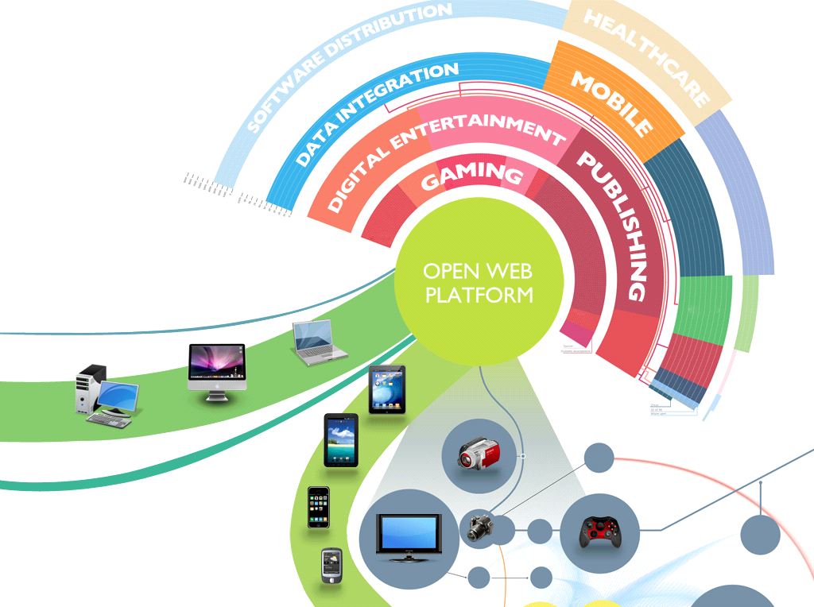
Converging Web
Copyright © 2018 W3C (MIT, ERCIM, Keio, Beihang)
Notes:
The Web is continuing to converge with different technologies, devices, and industry sectors. On the illustration this represented by the different devices connecting onto the internet. If I would re-draw this illustration today, I would add fridges, washing machines, and even my toaster. The illustration also represents different industry sectors such as mobile, gaming, digital publishing, healthcare, and many more. The Web is not anymore only what is in your browser but is increasingly all around us. It has moved away from what used to be a static and document-oriented format, to what is today a rich open platform – the Open Web Platform.

Slide 16
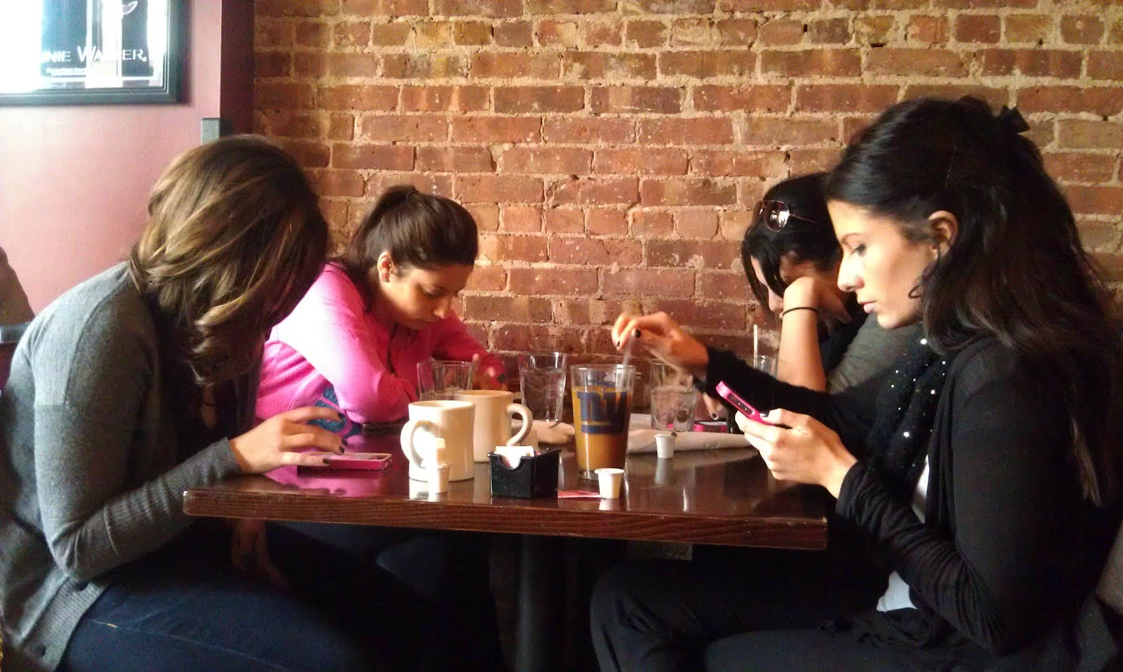
Mobile Web
Copyright © 2018 W3C (MIT, ERCIM, Keio, Beihang)
Notes:
Most prevalent is the move towards the mobile web. Most of us can no longer be separated from our mobile phones. Indeed, access through mobile has surpassed access through desktop. Also people with disabilities are using mobile. The line between native, hybrid, and web-based apps is blurry, which is why WCAG is increasingly applied across all three contexts. But there is more to do here.

Slide 17
Web of Things (WoT)
Copyright © 2018 W3C (MIT, ERCIM, Keio, Beihang)
Notes:
Also rapidly coming along at W3C is the “Web of Things (WoT)”. Currently the situation on the Internet of Things (IoT) is very fragmented. In the illustration, someone trying to access each sensor and device individually within an IoT system shouts “I hate my life!”. This is because each of these objects uses different – often proprietary – protocols and APIs. Accessing each is a pain. Yet the Web could serve as a universal interface to all these objects transparently, just like on the traditional internet. Most sensors and devices today can be access through HTTP. Someone else in the illustration accessing IoT systems through the open web protocol and APIs shouts “Easy-peasy!” because all the inters are cascaded away.
Increasingly objects are internet-enabled, such as smart-homes and entire smart-cities. This is an incredible opportunity for people with disabilities if we can ensure accessibility. Otherwise it has the opposite effect of excluding people with disabilities. This is not about the user interface because we already have WCAG for that. It is about the lower-level protocols. For example, can I connect my assistive technology to turn on the lights? Will I be able to configure my accessibility settings seamlessly and securely? We need to address this space.

Slide 18
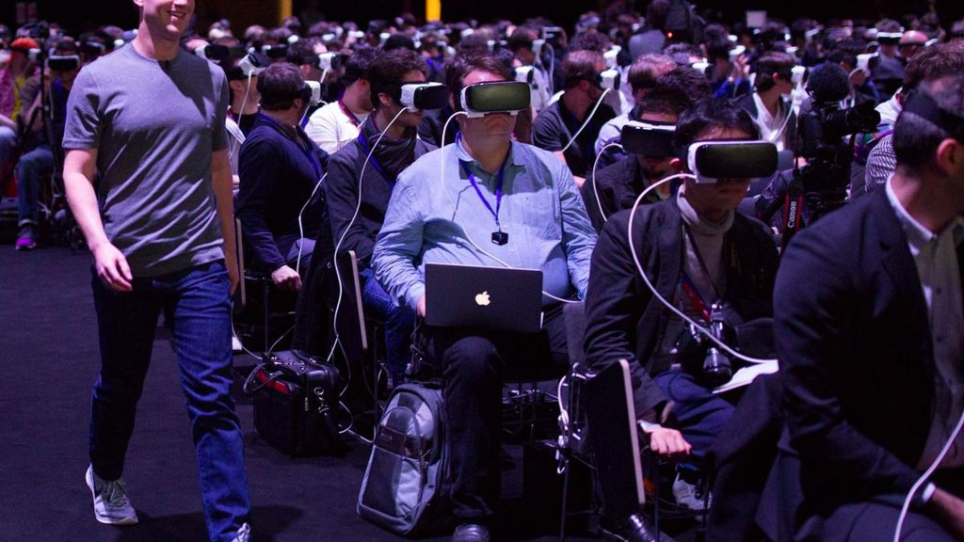
Virtual Reality
Copyright © 2018 W3C (MIT, ERCIM, Keio, Beihang)
Notes:
At W3C there is also on-going work on Virtual Reality – WebVR. Making VR accessible probably requires completely new approaches than what we have today, for example Artificial Intelligence to extract and abstract the pertinent information. We may not even fully understand the requirements at this stage, but is coming sooner than many may think.

Slide 19
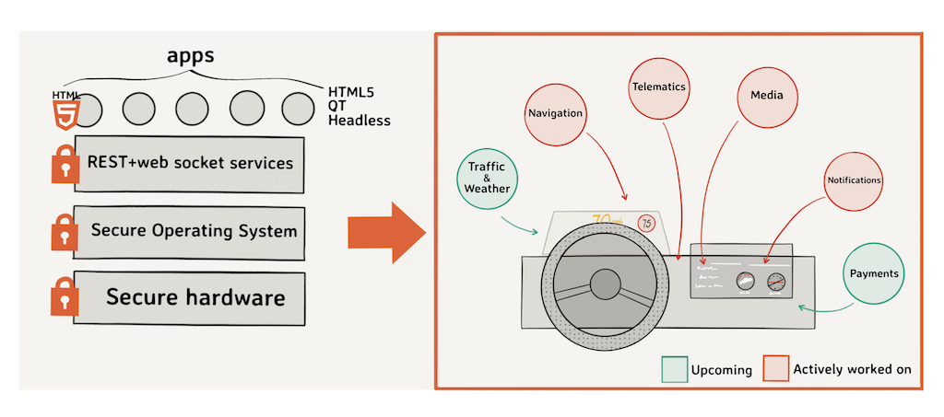
Automotive Systems
Copyright © 2018 W3C (MIT, ERCIM, Keio, Beihang)
Notes:
At W3C there is also on-going work on automotive. HTML5 apps access information from the internal network of the car, to provide the driver with navigation, telematics, media, and notifications on the dashboard. In next stages, more interaction with the external network, such as 5G, is foreseen. For example, to provide traffic and weather information, or even for payments such as road tolls. With increasing digitalization of the car, access to these systems be people with disabilities is increasingly and opportunity as well as a challenge.

Slide 20
Accessibility?
Addressing next generation web accessibility:
Analyzing user needs in the new contexts
Communicating user needs as use cases
Developing integrated technical solutions
Taking advantage of opportunities (eg. AI)
Evolving next generation WAI Guidelines
Copyright © 2018 W3C (MIT, ERCIM, Keio, Beihang)
Notes:
All these technologies rapidly evolving and converging into one ubiquitous system. What about accessibility? We need to take action now, to address accessibility now as these technologies are evolving, rather than after the fact. WAI is already carrying out related efforts, for example through its Research Questions Task Force (RQTF), yet much more collective effort is required. This includes to:
Analyze and understanding the specific user needs in these new contexts, which we do not yet fully grasp;
Communicate these user needs in appropriate formats, such as uses cases, to technology developers;
Develop integrated solutions as these technologies are evolving, to support accessibility natively and out-of-the-box;
Take advantage of key opportunities, such as Artificial Intelligence (AI), and other disruptive technologies;
Finally, we may need a completely new approach for the accessibility guidelines and implementation guidance.

Slide 21
Code Name “Silver”
Copyright © 2018 W3C (MIT, ERCIM, Keio, Beihang)
Notes:
Besides exploring some of the user needs, use cases, and accessibility requirements, WAI also has efforts on exploring the next generation guidelines. This slide is taken from the presentation of the corresponding WAI Task Force. The code name of this work is “Silver”. It is to date unclear what the exact scope of these guidelines will be, so it was temporarily labeled as “Accessibility Guidelines (AG)”. This happens to be the chemical name for silver in the periodic table, which has caught on as geek humor.

Slide 22
Silver Design Goals
Content:
Easier to use
Easier to reference
Easier to understand
Expanded scope
Inclusive of more disabilities
Inclusive of more perspectives
Inclusive of more technologies
Useful for more people
Process & Structure:
Based on evidence and data
Broadly communicate our efforts
Clear project milestones
Inclusive communication paths
Inclusive of more perspectives
Involve more stakeholders
Easier to maintain and update
Clearer update path
Copyright © 2018 W3C (MIT, ERCIM, Keio, Beihang)
Notes:
“Silver” is currently in very early exploration stage. It is not surprising that many known issues with WCAG 2 have come to light during this exploration, but also valuable breakdown of the problem areas. The group has also identified initial design goals which are currently more aspirational. The group is aware of the tensions between several of these often competing goals and that some balance will have to occur. Yet it is sometimes valuable to start from a clean slate and revisit the priorities and overall design. This is exciting work under way, and there is much opportunity to participate if you are interested.

Slide 23
Web Accessibility
Copyright © 2018 W3C (MIT, ERCIM, Keio, Beihang)
Notes:
Coming back to our “current approach” to web accessibility, it is clear that some areas are shifting and not anymore very accurate in the illustration. For example, today there are many APIs built on top of the technical specifications, which are currently not represented. Also the separation between “developer” and “user” is diminishing in the era of social media, content management systems, and seamless content creation and consumption. It is also questionable whether the trilogy of guidelines is still apt and to what extent. Yet these components remain critical aspects of web accessibility and will need continued development regardless of where they appear on an illustration. There exciting future trends and on-going developments for anyone who wants to get involved.

Slide 24
Thank You
Shadi Abou-Zahra
w3.org/people/shadi
shadi@w3.org
@sabouzah
Copyright © 2018 W3C (MIT, ERCIM, Keio, Beihang)

