Slide 1
Did we learn something?

Slide 2
Our warmest thanks to …
Speakers
Moderators
Technicians
Interpretersstaff
Participants

Slide 3
“Lovely code leads to accidental experts”
@lyzadanger

Slide 4
“We can include everyone, and therefore we have to do it. Otherwise, design is mere decoration.”
@davidberman

Slide 5
“Momentum is growing, but we have to work together”
@lyzadanger

Slide 6
“Instagram is awesome - I take the pictures, you tell me what it is all about”
@BlindFilmCritic

Slide 7
“Bananas as input devices? I didn’t see that coming”

Slide 8
“If everyone can't enjoy what your making - why make it?”
@chrisfeix

Slide 9
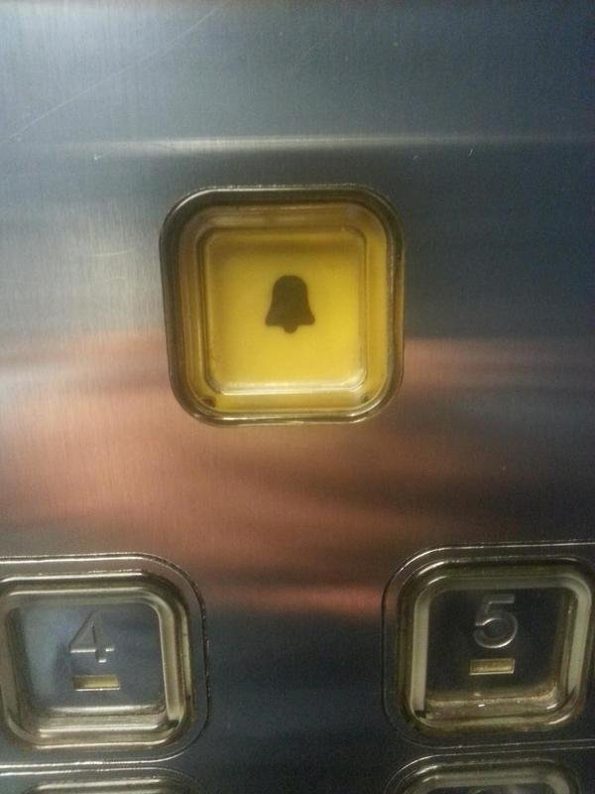
”VERY disappointed by the Darth Vader button in the lift. It should have a picture of an angry fireman on it instead.”
@heydonworks

Slide 10
Yes, slides are online
www.funka.com/FTD-15
www.funka.com/no/FTD-15
www.funka.com/en/FAD-15

Slide 11
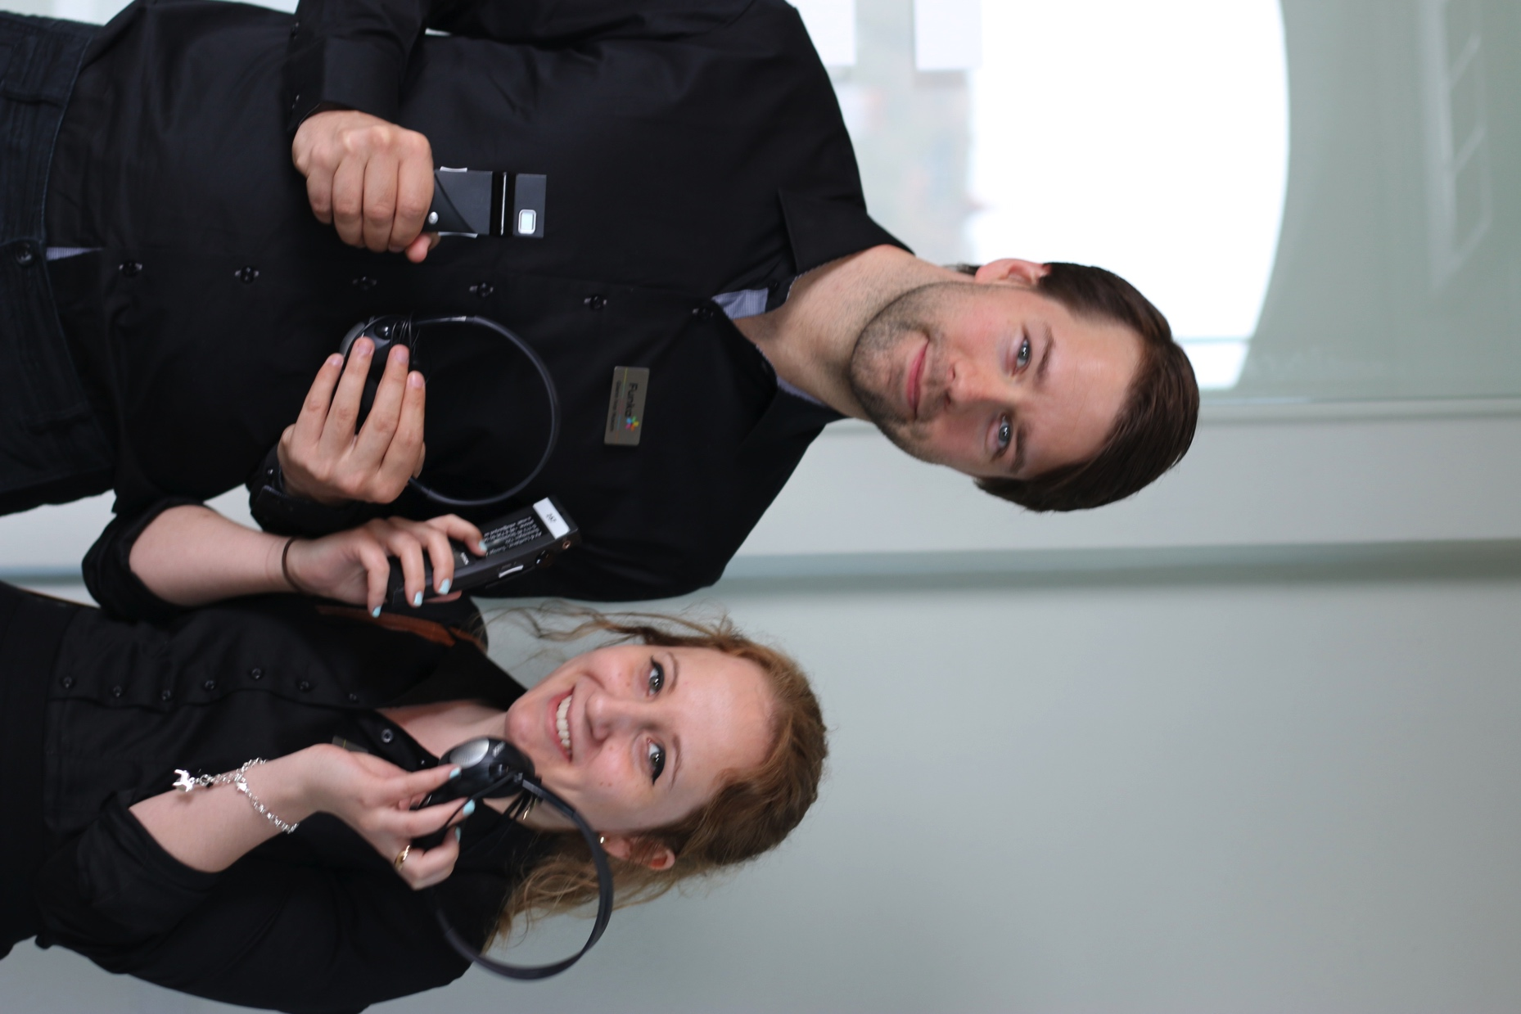
Please return the headsets

Slide 12
Welcome back next year!

