Slide 1

The WCAG 2 roll-out: how did we do?
Web Content Accessibility Guidelines (WCAG)
David MacDonald
President
CanAdapt Solutions Inc. david@can-adapt.com www.can-adapt.com
613-235-4902
Twitter @davidmacd

Slide 2
Who we are, and who we aren't
David MacDonald
President - CanAdapt Solutions
WCAG since 2002
HTML5, Mobile Task Force
Editor of “Using WAI-ARIA in HTML5”
Former lead consultant but not an official voice
Notes:
Hands on tech. for people with disabilities
Lead consultant with Treasury Board Secretariat on Donna Jodhan WCAG roll out

Slide 3
These slides are ONLINE
davidmacd.com/slides/funka

Slide 4
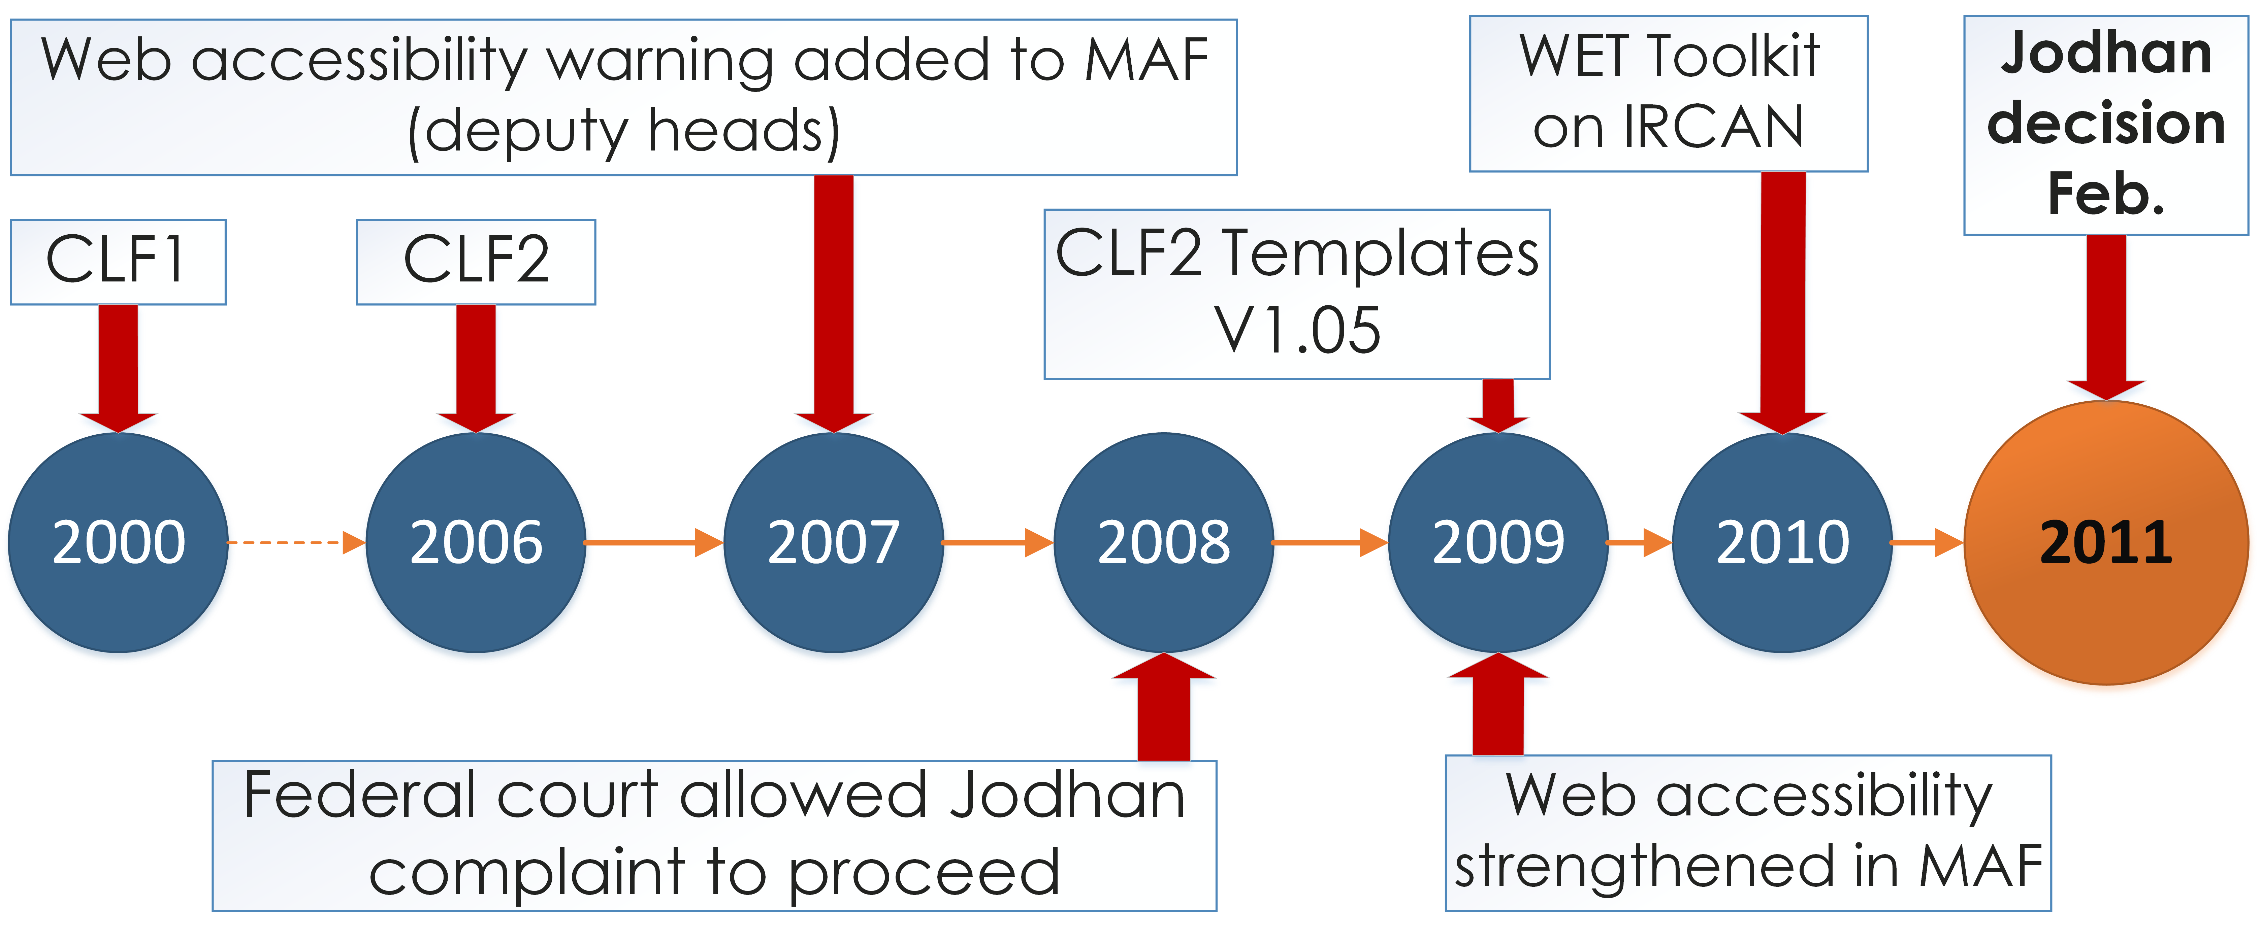
Accessibility before Jodhan
The standard was uneven in application across departments.
The phones of WCAG consultants were quiet.

Slide 5
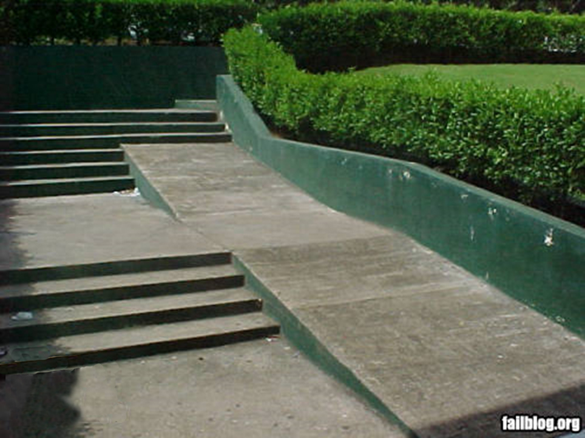

Slide 6
Donna Jodhan v. Canada
Feb. 2011, Judgment
Violation of section 15(1) of the Charter; Discrimination based on physical disability(Sec. 1)
Update the CLF Standard to WCAG 2 (Sec. 100)
NOTE: GC was heading towards WCAG 2 anyway
Constitutional obligation
Jodhan v. Canada (Attorney General)
http://decisions.fct-cf.gc.ca/site/fc-cf/decisions/en/item/58711/index.do

Slide 7


Compliance in “Reasonable” period such as 15 Months!??”
106 departments
1,500 web sites
10,000,000 web pages
800-900 applications
700 social media sites

Slide 8

WhatdoIDoNOW!??????
How much
will it cost?
Who’s gonna pay?
Where do we learn
about this?
Who do I call?
Will my staff get
anything else done?
How are we gonna
do everything?

Slide 9

How to get from here!
http://julianvasquezheilig.files.wordpress.com/2014/01/head_in_sand.jpg

Slide 10

To here!

Slide 11
Created
“Standard on Web Accessibility”
Set up procedures to measure progress
Created reporting templates
Stepped up monitoring & response
Created automated checker

Slide 12
Adjusted timetable - prioritized
Phase I (Aug. 2011 - 8 months)
  home pages & 1st level, most important info & service, most frequently used, new Web pages
Phase II (Mar. 2012 - 6 Months)
  additional Web pages info. & services, frequently used
Phase III (11 Months)
  remaining Web pages

Slide 13
Defined temporary exceptions
Complex maps (WCAG 1.1.1)
Live Video Captions (WCAG 1.2.4)
Audio Description (WCAG 1.2.5)
(health & safety videos audio described)

Slide 14
What is the WET Toolkit
Templates
Widgets from libraries like jQuery and/or designed internally
Provides QA & accessibility tools including automated accessibility checker

Slide 15
Established consequences for deputy heads
Responsible for taking corrective measures in organization …
Any consequence allowed by Financial Administration Act
Corrective actions include removing content
Web Accessibility Standards
http://www.tbs-sct.gc.ca/pol/doc-eng.aspx?id=23601&section=text

Slide 16
Departments were asked to:
Develop strategy for 100% WCAG compliance
Reduce redundant, outdated & trivial content (ROT)
Archive web pages
Implement WET
Collaborate w/ other depts. common challenges
Train web developers & content providers
Engage outside help where necessary
Notes:
Develop strategy to reach 100% WCAG compliance
Reduce redundant, outdated & trivial content (ROT)
Archive web pages, where applicable
Implement Web Experience Toolkit
Participate in government-wide collaboration to address common challenges
Train web developers and content providers
Engage outside help where necessary

Slide 17
Few Accessibility Experts - Huge Demand
Felt like Cobol programmers in 1999
GC participated in local association of accessibility professionals
Private sector trained over 2000 developers
GC developed internal WCAG training for over 2000 developers
Notes:
Accessibility experts became like Cobol programmers in 1999
GC participated in an association of accessibility professionals and trainers
Private sector trained over 2000 developers
GC developed internal WCAG training, trained over 2000 developers

Slide 18
Follow Standards
Involve Stakeholders
Accommodate
Individuals

Slide 19
1. Follow Standards
Follow Standards
Follow Standards
Migrated to WCAG 2
Required validation of HTML code which improves accessibility

Slide 20
2. Involve Stakeholders
Involve Stakeholders
Engaged group of Gov. Employees w/ disabilities
Turned WET into GitHub open source collaborative
CodeFest 2012 & 2013 (400 developers)
Regular conference calls and WEBEX with other countries

Slide 21



Nothing about us without us
Public Service Employees
Involve Stakeholders
Neighbours, brothers, grandmothers, welders, politicians, Canadian citizens, mothers
Photographers
Grandchildren
Welders
Neighbours
Politicians
Mothers
Brothers
Clients of Government Services
Canadian Citizens

Slide 22
3. Accommodate Individuals
Government historical and/or archived information …in a database … provide in an accessible format upon request;
Jodhan v. Canada (Attorney General)
http://decisions.fct-cf.gc.ca/site/fc-cf/decisions/en/item/58711/index.do
Accommodate
Individuals

Slide 23
Was the WCAG rollout a success?
“Canada/EU most accessible websites of 14 governments tested”
- International comparative audit iTnews for Australian Business
“I am delighted … this matter has finally ended with a victory for all Blind, partially sighted and deaf/blind Canadians.” - Donna Jodhan
http://www.bakerlaw.ca/164/contenthistoric-victory-makes-websites-accessible-blind-canadians/

Slide 24
What is the value to people with disabilities?
“The Government of Canada has largely met compliance obligations.” CNIB http://www.bakerlaw.ca/164/contenthistoric-victory-makes-websites-accessible-blind-canadians/
“The Government of Canada sites are about the most accessible out there”
-Brian Moore, expert Screen reader user who is blind

Slide 25
How can we maintain a WCAG conforming web presence?
Remember ongoing “Constitutional Obligation”
Continue monitoring WCAG
Increase collaboration w/ general public, provinces and municipalities
Streamline web presence 1,500 sites to 1-6 sites
Task-based usability navigation

Slide 26

Lessons learned for implementing the Accessibility
Now it’s everybody else’s turn…
Other
Countries,
Provincial
Municipal
Governments
NGOs, Private sector

Slide 27
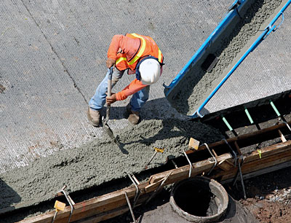
Include accessibility when the
Cement is
Wet!
Procure accessible products, build accessible processes

Slide 28
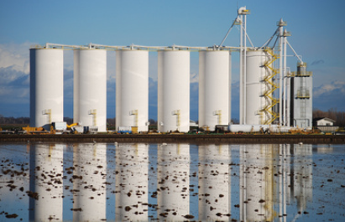
Is this your Development Cycle…

Slide 29
Create cross department collaboration
Create cross department committees
Developer’s wiki to share tips, tricks, links
Monthly one-hour conference call
Share emails, phone numbers

Slide 30
How to save time & money
Move accessibility upstream
Non-techie training form content creators
Move navigation accessibility to UI phase
Get the colour contrast and layout right in the design & prototyping phase

Slide 31


How to save time & money (cont’d)
Get the templates right
Leverage accessible libraries (WET, SOME jQuery, etc.)
If you adapt/improve accessibility to open source widgets, give it back to the community
Set up a central captioning strategy

Slide 32
What are the other benefits of web accessibility?

Slide 33
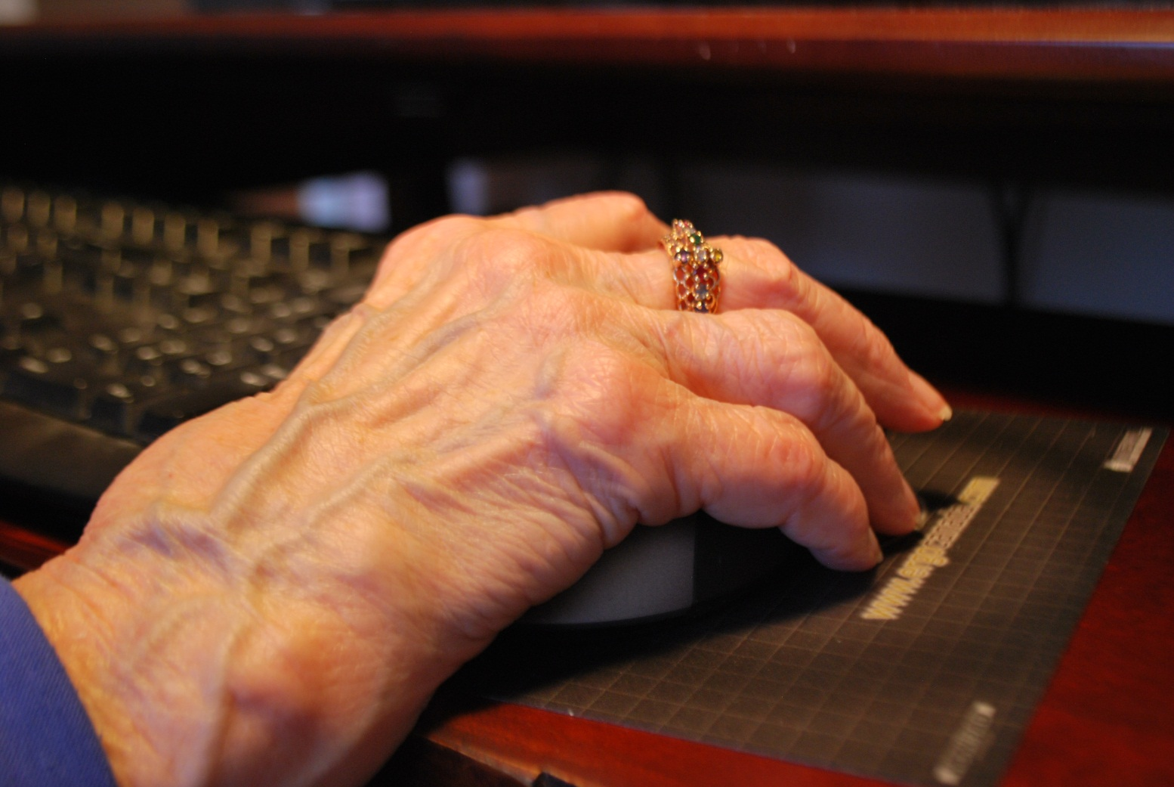
3 year W3C study: correlation between needs of older people and people with disabilities

Slide 34
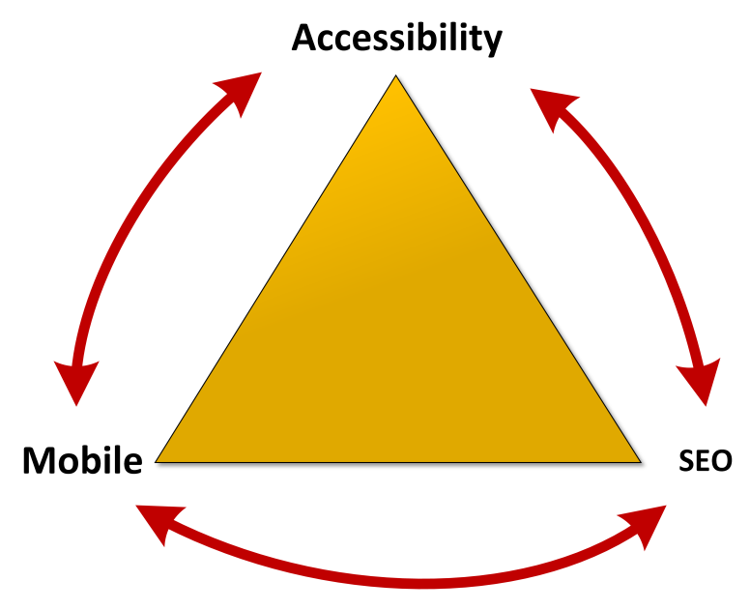

Slide 35


David MacDonald
david@can-adapt.com
www.can-adapt.com
613-235-4902
Tweets @davidmacd

