Slide 1
Digital tillgänglighet:
WCAG för utvecklare – Egen kontroll
johan.kling@funka.com

Slide 2

Johan Kling
COO & CQO
Webbutvecklare sidan mitten av 90- talet.
Tillgänglighetsexpert
Operativ chef & kvalitetschef för alla våra leveranser, produkter och konsulter.
Plus, jobbar aktivt med projektledning, användningstester, interaktionsdesign, systemarkitektur, utbildning och utveckling.
Certifierad via IAAP - CPWA & ADS

Slide 3

Målet för dagen
Repetera viktiga punkter i EN301549/WCAG relevanta för utvecklare.
Testa några punkter själv
Redovisa hur ditt test har gått.

Slide 4



Under presentationen
Om du har andra frågor:
Skriv i chatten så svarar vi under frågestunden på slutet.

Slide 5
1: Exempel på kriterier från WCAG relevanta för utvecklare.

Slide 6
Keyboard

Slide 7
The interface can be controlled by keyboard on both desktop and mobile
This also includes that the user should not have to time inputs in order to navigate and the user should be able to navigate in and out of functions/components, regardless of input method.
WCAG 2.1 2.1.1 (A) | 2.1.2 (A) | 3.2.1 (A) | 3.2.2 (A)

Slide 8
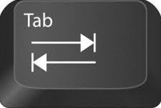
Keyboard navigation follows a logical order
HTML5 has many elements with embedded keyboard navigation like buttons, inputs, links etc.
Navigation is usually done with the tab or arrow keys.
Keyboard navigation follows how the objects are placed in the code.
Can be determined automatically by default structure (recommended) or manually by specifying the order.
EXAMPLE
1
2
3
WCAG 2.1 2.4.3 Focus Order (A)

Slide 9
Keyboard navigation follows a logical order
tabindex = "0"
- allowing any element to be focusable and to trigger an interaction. Follows the structural order in the code. Use only when necessary.
tabindex = "1"…
- used to control TAB-order. NOT recommended unless it´s required.
tabindex ="-1"
- used when elements only should be focusable in certain circumstances. (e.g modal dialog)
WCAG 2.1 2.4.3 Focus Order (A)

Slide 10
Keyboard focus

Slide 11
Focus is clearly displayed when users navigate with the keyboard
When the user navigates with a keyboard on a website or in a function, the focus must be clearly displayed.
Hidden links and shortcuts should also be highlighted and displayed visually when they receive focus with keyboard navigation.
WCAG 2.1 2.4.7 Focus Visible (AA)

Slide 12
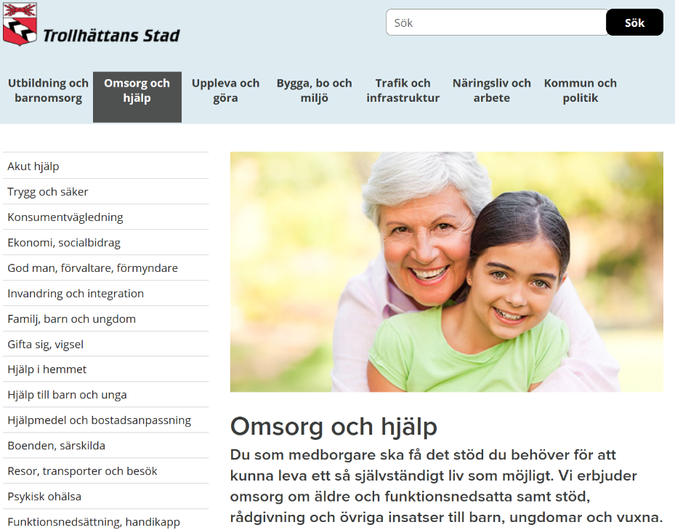
Focus is clearly displayed when users navigate with the keyboard
WCAG 2.1 2.4.7 Focus Visible (AA)

Slide 13
Focus is clearly displayed when users navigate with the keyboard
The highlight needs to be easily identifiable, so the built-in focus highlight in web browsers may not be enough.
Use a thicker border, thick underlining, inversion of color, etc.
Default is approved
Specified is better
WCAG 2.1 2.4.7 Focus Visible (AA)

Slide 14
Landmarks

Slide 15
Link groups and information areas are grouped
This requirement helps the user identify groups of objects/elements and their role in the interface.
Use landmarks to mark different types of content, it provides an additional structure for users who can´t see.
EXAMPLE
<nav>
<header>
<footer>
<main>
<article>
………..
WCAG 2.1 1.3.1 Info and Relationships (A)

Slide 16
Link groups and information areas are grouped
Use at least the structural elements <nav> and <main>. Also use the wai-aria attribute role="search" for the search form.
Don’t use the role attribute if there is an equivalent HTML5 element.
EXAMPLE
<nav aria-label="Top menu">
<ul>
<li>
<a href="/design-for-all/">
Design for all
</a>
</li>
</ul>
</nav>
<div role="search">
<input type="search">
<input type="submit“ value="Search">
</div>
WCAG 2.1 1.3.1 Info and Relationships (A)

Slide 17

Link groups and information areas are grouped
<header>
role="search"
<nav>
<main>
<footer>
WCAG 2.1 1.3.1 Info and Relationships (A)

Slide 18
Expanded or not expanded?

Slide 19
Use aria-expanded for areas that can be expanded and collapsed
Aria-expanded is added to the button (or link) that expands the area.
True indicates the area is expanded, false that it is collapsed. These values must be dynamically set.
EXAMPLE
<button aria-expanded="true">
Open/Close
</button>
<div>
Content
</div>
WCAG 2.1 4.1.2 Name, Role, Value (A)

Slide 20
Use aria-expanded for areas that can be expanded and collapsed
<button aria-expanded="true">Menu</button>
<nav>
<ul>
<li>
<a href="/design-for-all/">Design for all</a>
<button aria-expanded="false">Sub menu for Design for all</button>
</li>
<li>
<a href="/we-offer/">We offer</a>
<button aria-expanded="false">Sub menu for We offer</button>
</li>
</ul>
</nav>
WCAG 2.1 4.1.2 Name, Role, Value (A)

Slide 21
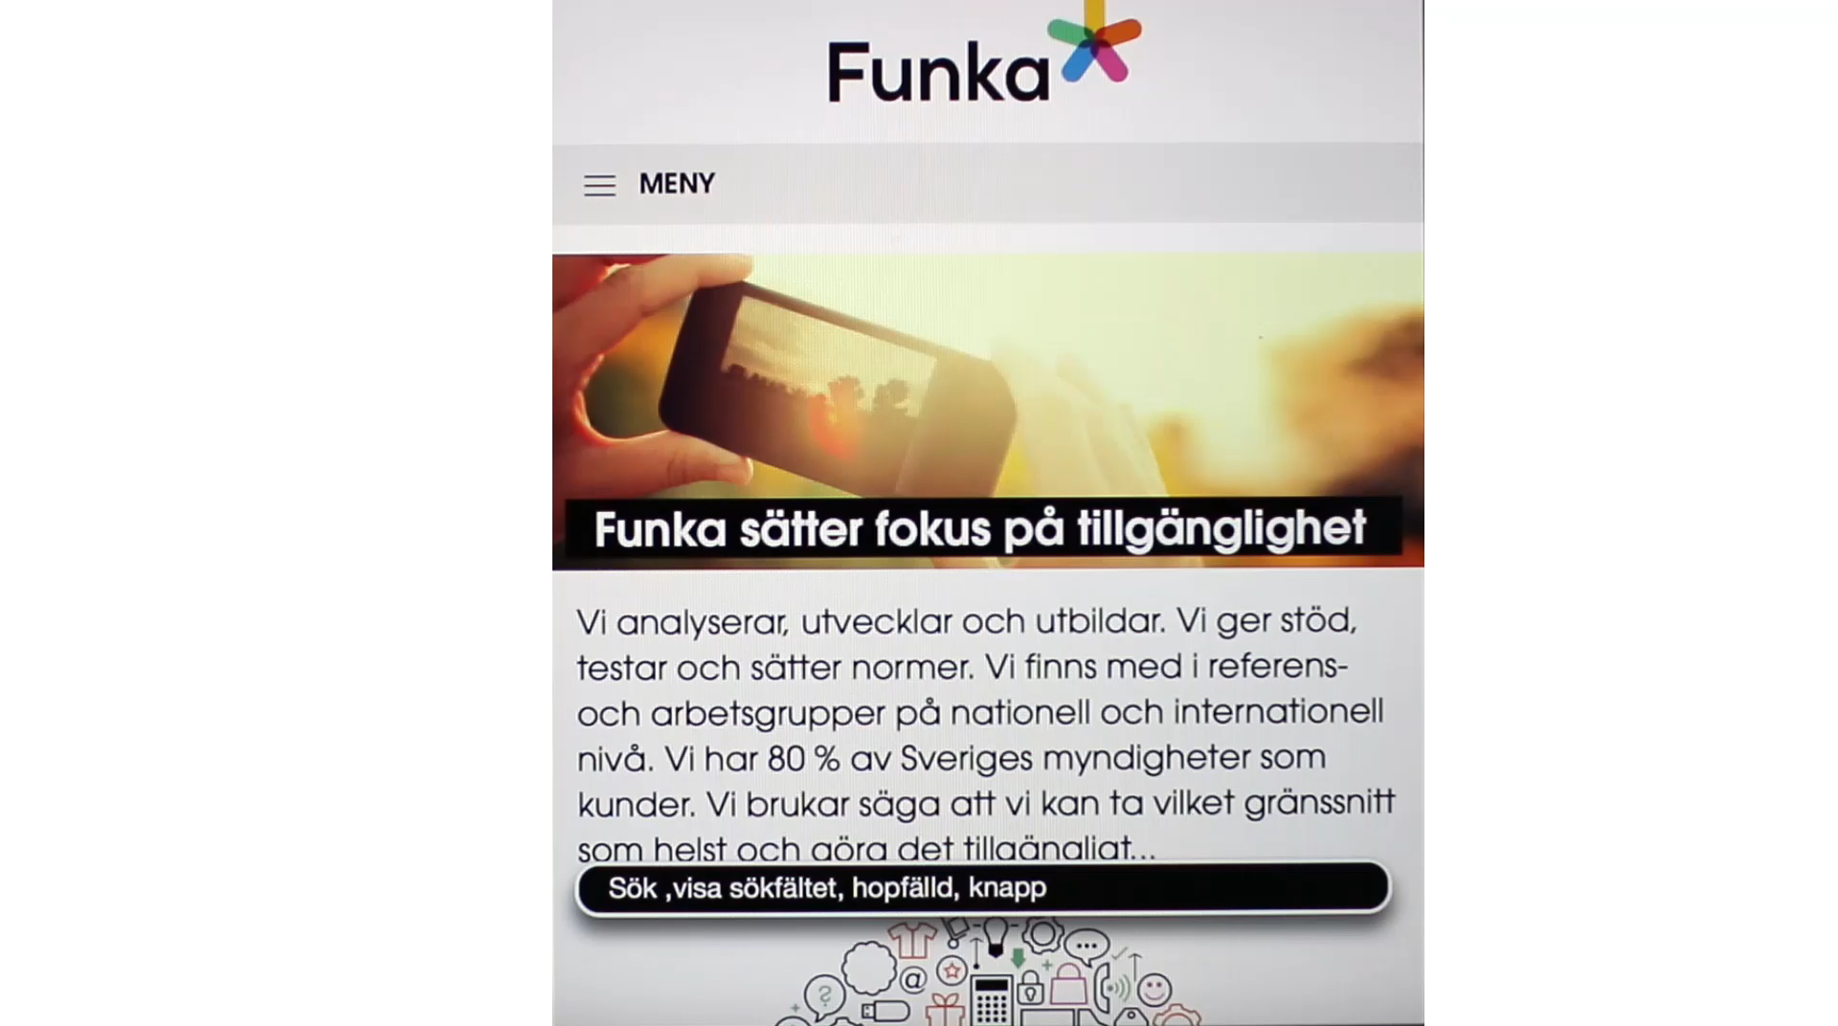
SW100) Use aria-expanded for areas that can be expanded and collapsed

Slide 22
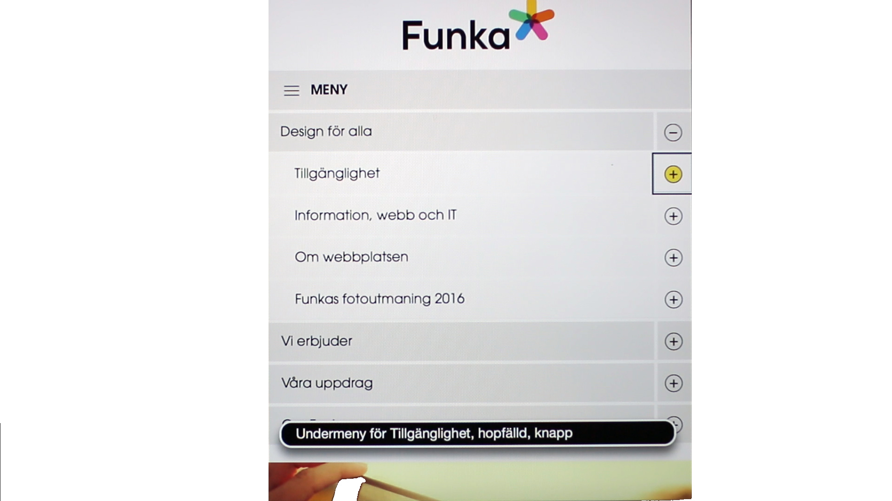
SW100) Use aria-expanded for areas that can be expanded and collapsed

Slide 23
Do not overuse!

Slide 24
Don’t overuse WAI-aria
Name:
<label id="label" for="text" aria-hidden="false">Name</label>
<input id="text" role="input" type="text"
aria-label="Name" aria-labelledby="label" aria-describedby="label"
aria-multiline="false" aria-readonly="false"
aria-required="true" required aria-invalid="false"
aria-hidden="false" aria-disabled="false" />
<label for="text">Name</label>
<input id="text" required type="text" />
Tips

Slide 25
Gratis bra verktyg!

Slide 26
Dagens testobjekt
Älgdata - Startsida - Älgdata (algdata.se)
Planeringskatalogen - Startsida - Planeringskatalogen
Vatteninformationssystem Sverige, VISS - Välkommen till VISS (lansstyrelsen.se)
Nationella Kalkstensdatabasen - InformationssystemKalk (lansstyrelsen.se)

Slide 27
Dagens Uppgifter
Testa att alla interaktiva element går att nå med tangentbord
Testa att fokusmarkeringen är synlig för varje element.
Testa att allt innehåll ligger inom ett landmärke.
Testa att varje sida innehåller en <main>
Testa att det finns <nav> landmärken och att de är unika.
Leta och testa expanderbara element och att de innehåller aria-expanded samt att det ändrar värde.
Bonus: Leta efter överanvänding av WAI-ARIA kod.

Slide 28
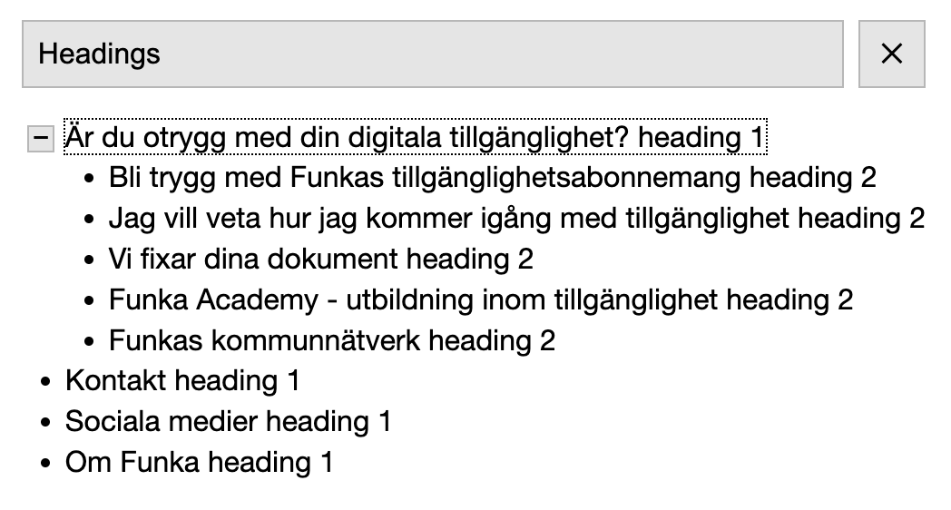
Bokmärket a11y- outline
Bokmärket a11y- outline kan bland annat lista rubriker
https://xi.github.io/a11y-outline/
Tips

Slide 29
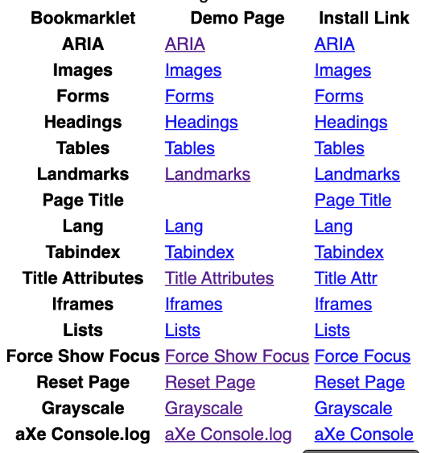
Bokmärken från Paul J Adam
Bokmärken från Paul J Adam kan bland annat visa rubriknivåer och alt-texter
pauljadam.com/bookmarklets/
Tips

Slide 30
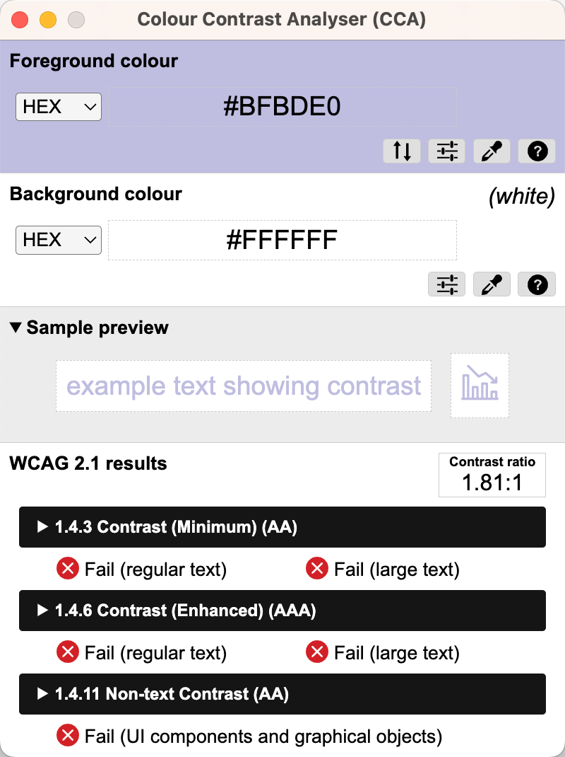
Colour Contrast Analyser
Colour Contrast Analyser är ett verktyg för att mäta kontraster
https://www.tpgi.com/color-contrast-checker/
Tips

Slide 31
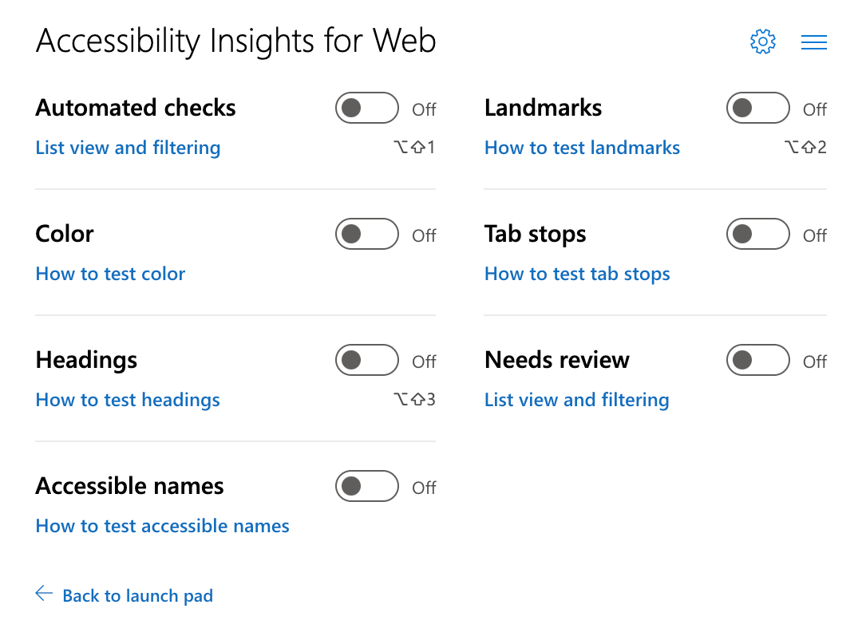
Accessibility Insights
Accessibility Insights är en program med flera testverktyg, bland annat bra visuella verktyg i Ad Hoc Tools
https://accessibilityinsights.io/
Tips

Slide 32
2: Testperiod

Slide 33
Jimmy Larsson
Edvin N Fackel
Ronny Hägerman
Niklas Oscarsson
Sally Sandberg
Mats Forsberg
Elin Fältman
Pontus Ihlström
Thomas P Johansson
Oscar Lundberg
Andreas Edin
Fredrik Ankargren
Johanna Backström
Emil Carlsson-Heurlén
Roger Edvardsson
Rickard Hammarberg
Cornelia Pfeiffer
Mattias Selldén
Tommy Hildingsson
Älgdata
https://www.algdata.se
Planeringskatalogen
https://www.planeringskatalogen.se
Vatteninformationssystem Sverige, VISS -
https://viss.lansstyrelsen.se
Nationella Kalkstensdatabasen
https://kalkdatabasen.lansstyrelsen.se

Slide 34
3: Redovisning

Slide 35




Slide 36
https://www.funka.com/lsu

Slide 37
Det finns inga normalanvändare

