Slide 1

accessibility is kinda like… Jim Tobias Inclusive Technologies inclusive.com
Notes:
2/15/2016 call w susanna
Modify for euro-audience
80% of audience will be public sector potential funka clients.
They do not focus on compliance – so don’t
They don’t see pwd as customers – democratic or just assumed mutual interest
Note eu nutrition labeling – swedish keyhole
Photo
4-5 lines of presentation, 4-5 lines about me.
Tech team will contact

Slide 2
Introduction
ICT accessibility lives in a complex environment:
fast-moving technologies
market forces
public policies and programs
Analogies to other issues can show us how to improve our accessibility work

Slide 3

Pollution

Slide 4
Pollution
By-product of manufacturing and use
Economic concept of externalities
However:
industrial pollution is unidimensional, easy to measure, relatively non-contextual
Policy tools:
prohibition & regulation
market stimulation
cap and trade

Slide 5

Nutrition

Slide 6
Nutrition
Supply or demand problem?
obesity > hunger (2012 FAO report)
Value chain
farmer…flour mill…bakery
OS…browser…website…video
Is the information reaching the right people at the right moment?

Slide 7
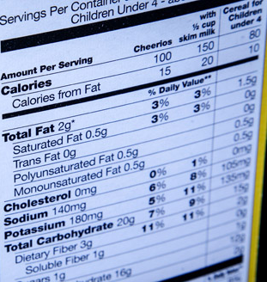

Nutritional Information

Slide 8
Nutritional Information
Active awareness
nutrition is part of public dialogue
accessibility depends on context and user
many dimensions
not easy to measure
consumer understanding
industry resistance
Notes:
88% of K-5 teachers teach nutrition http://nces.ed.gov/quicktables/Detail.asp?Key=286
~50% of K-5 teachers have had formal prep. for teaching nutrition http://nces.ed.gov/surveys/frss/publications/2000040/

Slide 9
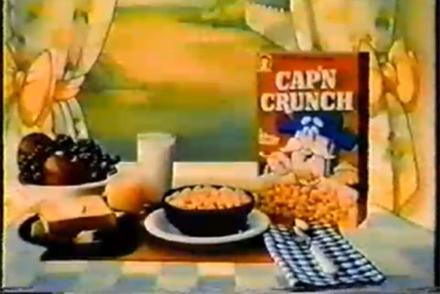
“Part of a Complete Breakfast”

Slide 10
“Part of a Complete Breakfast”
Deep context:
user’s goal
user’s abilities
Ecosystems of products and features
Role of peers, experts, information resources
Notes:
SETT

Slide 11
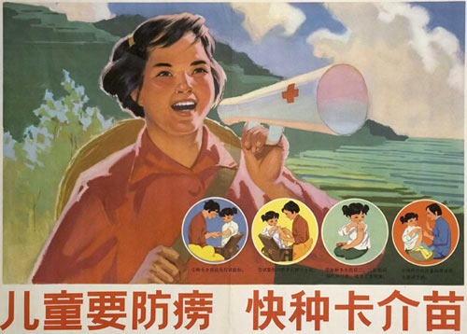
Public Health
Notes:
ph empl
Health Educators and Community Health Workers: 99K
Occupational Health and Safety Specialists: 63K
OT 113K; SLP 134K
Registered Nurses 2.7M
Epidemiologists 5K

Slide 12
Public Health
A vaccination campaign has more impact than a new vaccine
not a supply problem
Knowing actual behaviors is crucial
what people do/don’t do about their health can lead to improved care/self-care
how infectious agents arise and operate lets us prepare for epidemics
Notes:
only ~40% of prescriptions are filled
diabetes ‘compliance’ is ~10%
only 1/3 – ½ of people who have received screen reader training become successful users of screen readers.

Slide 13
Summing Up
Accessibility is a social movement
Fitting accessibility into the public dialogue
usability, social role of technology
Data and analysis
what do people do/use?
“total social cost of inaccessibility”
Professionalization & sustainability

Slide 14
Thank You! tobias@inclusive.com

