Slide 1
Accessible UX: Beyond the checklist (To make great accessible experiences)
Whitney Quesenbery
@whitneyq | @AWebforEveryone
Funka Accessibility Days, April 2016

Slide 2
What we will talk about
Usability and accessibility
How problems interact
Accessible UX needs diversity
Rethinking usability testing
Going forward

Slide 3
Usability and accessibility Twins separated at birth
3

Slide 4
4
Usability
The effectiveness, efficiency and satisfaction with which the intended users can use a product to meet their goals ISO 9241-11
Accessibility
The usability of a product, service, environment or facility by people with the widest range of capabilities. ISO 9241-20

Slide 5
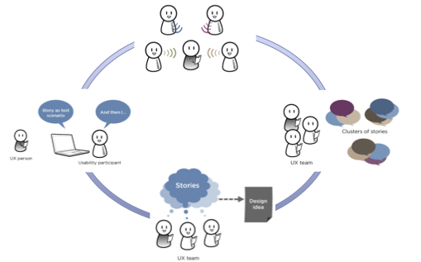
The user-centered design process
1. Understand people and context of use
2. Identify requirements
4. Evaluate with users
3. Explore design solutions
Source: ISO 9241-210 (formerly ISO-13407)

Slide 6
Accessibility error priorities
Critical An absolute barrier to access
Serious A barrier that could cause frustration to most and be a barrier to some, causing a need for work-arounds
Moderate A frustration that would not prevent someone from using the site
Minor A WCAG error that is unlikely to cause problems
- Glenda Sims, Deque
Source: 2103 Accessibility Summit: http://environmentsforhumans.com

Slide 7
Usability problem priorities
Critical A problem that will prevent some users from completing a common task
Serious A problem that will slow down some users and force them to find work-arounds
Medium A problem that will cause frustration but will not affect task completion
Low A quality or cosmetic problem, such as a spelling error, that can damage the credibility of a site.
- David Travis, User Focus
Source: http://www.userfocus.co.uk/articles/prioritise.html

Slide 8
Prioritize problems by their impact on people
Type of problem | What it means
Slammed doors (critical) | Barriers that stop someone from using an app or feature successfully – or at all
Frustrating (serious) | Problems that slow someone down, or force them into work-arounds
Annoying (moderate) | Things that make the experience less pleasant (maybe even enough to leave)
Noisy (minor) | Minor issues that damage credibility but are unlikely to cause problems

Slide 9
Accessibility testing in layers
Principle | Testing mode | What it tests
Perceivable | Inspection | Basic accessibility errors
Robust | Code review | Use of code standards Semantic structure
Operable | Check using AT Expert review | Interaction using keyboard, screen reader, other AT
Operable/ Understandable | Usability testing | Use by real people

Slide 10
Inspection Check for basic accessibility errors
Quick checks that are perceivable without special technology
Image "alt" text
Text size and contrast
Captions and transcripts
Meaningful links and buttons
Easy access to content (skip links)
Keyboard navigation
Notes:
Almost all of the most common – and basic – accessibility problems can be found through inspection.
There are a few tools that are useful – accessibility testing tools can help automate the process, for example checking for alt text, and testing the contrast.
One of the heuristics is that you can catch a relatively low percentage of a11y problems (about 20-30%) with automated tools. But that just makes it even more ridiculous that they exist at all.

Slide 11
Code review Check for accessible coding
Look for robust code that meets standards.
Forms coding
Semantic markup for content structure
Reading order with a keyboard
Coded to W3C standards
Appropriate use of ARIA and HTML5 elements
Notes:
The next round of testing looks at the robustness of the code. Just as in web development in general, there is a strong movement towards standards-based code in a11y. Instead of catering to AT, we are starting to expect AT to meet code ina robust standard.
These tests can also be done without using any special AT, by inspecting the code, or working through the pages with keyboard alone.

Slide 12
Use Check with assistive technology
Check that it is operable and understandable with assistive technology. Use the technology with
Screen readers: NVDA, VoiceOver or JAWS
Magnifiers: Browser magnification and ZoomText
Keyboard: Emulators, dual switches, Braille notes
Notes:
Next, you need to actually check the site with assistive technology. In general, you can look at three basic types of AT.
For bonus points, you might look at Braille note readers, because (a) they are common and (b) they are critical to the deaf-blind (and they might be one of the more common types of personal AT we might see at a polling place)

Slide 13
Expert review Check with expert AT users
Expert review by people who use assistive technology to be sure it is operable and understandable.
Does it work well with a range of AT?
Are there good cues for navigation and orientation through the task?
Can they complete all basic tasks, from the start to finish?

Slide 14
Usability testing Check with voters with disabilities
Test again with a diverse set of "regular users" to be sure it works for non-experts.
Can they complete all basic tasks, from the start to finish?
Does it work with their own AT, with their usual settings?
Are there good cues for navigation and orientation through the task?

Slide 15
Usability and accessibility problems interact When interaction problems hide
Notes:
These examples are drawn from our experiences doing usability testing. Although we show partial screens from real site, these are simply typical problems, and not unique to those sites.
In most cases, these companies are actively working on both usability and accessibility, and some of the issues described in this presentation have already been fixed.

Slide 16
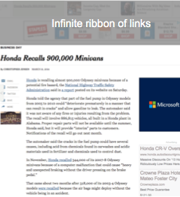
Noisy problems mask critical ones
Accessibility (noisy)
Missing alt text
Inconsistent heading coding
Confusing labeling of sections
But the real problem was
Accessibility (critical)
No way to jump past the infinite ribbon at the top of the page

Slide 17
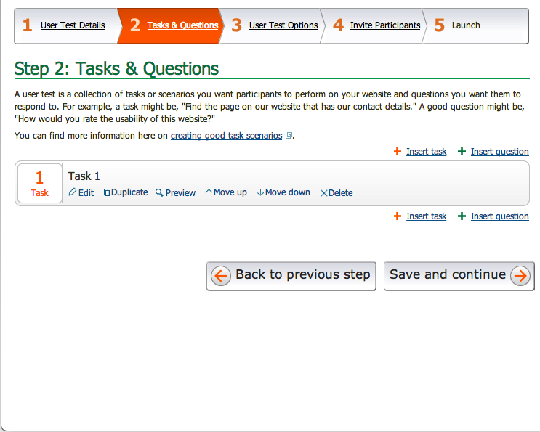
Critical features may not be accessibly usable
Accessibility (serious)
The overall site is accessible
but
The insert task links rely on visual position
Insert Task
Insert Task
Thanks to Jayne Schurick and Jeanine Lineback for this example

Slide 18
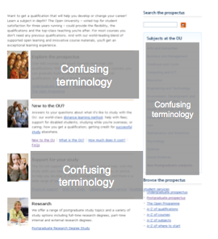
Participants with disabilities add perspectives to a usability problem
Usability & accessibility (serious)
The general interface is both usable and accessible, but the language and terminology in the content created serious and critical problems for people who did not know university terminology.

Slide 19
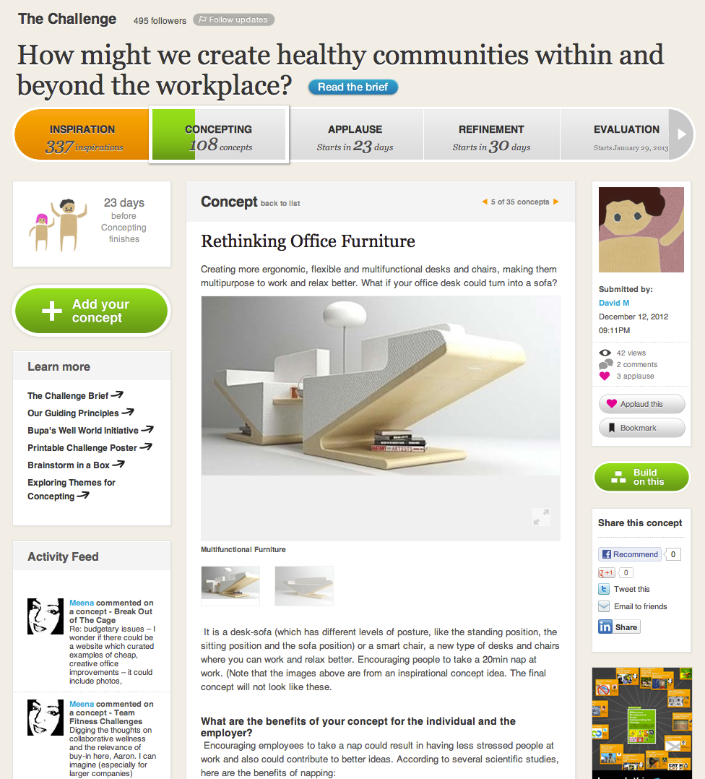
People with disabilties can show where orientation is difficult
Usability (serious)
Complicated structure of a page for an unusual interactive site. Everyone had trouble learning how to use the site
Accessibility (critical)
Missing semantic coding made it impossible to distinguish different sections of the page and join the challenge.
Challenge Phases
Main Content
Bio
Stats
Share links
Activity feed
Related themes
User Comments
Source: OpenIDEO.com

Slide 20
To understand accessible UX we have to look at real people and real behavior.

Slide 21
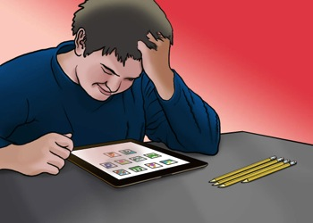
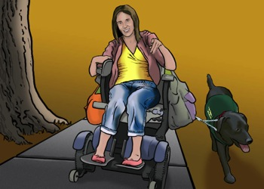
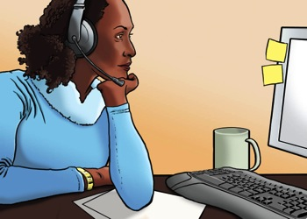
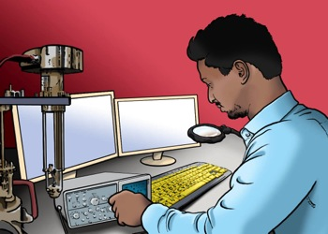
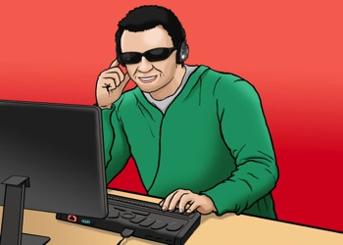
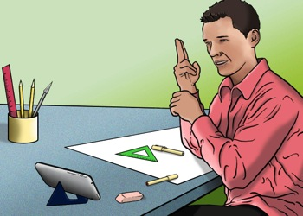
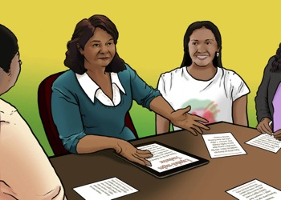
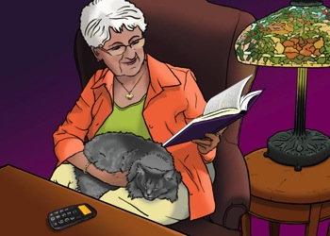
Accessible UX needs diversity
People with different interaction styles make usability testing more valuable.
Source: rosenfeldmedia.com/books/a-web-for-everyone/#resources

Slide 22
Recruit "people" not "disabilities"
Aptitude motivation, emotion, risk tolerance, persistence, optimism, tolerance for frustration
Attitude current knowledge, ability to make inferences or innovate solutions, expertise, habits
Ability needs and preferences for interaction and display, digital and reading literacy
http://www.slideshare.net/danachisnell/character-creator

Slide 23

Vishnu "I want to be on the same level as everyone else"
Engineer working on software for medical products
Speaks 5 languages
Needs to adjust text size and contrast to see the screen well

Slide 24

Vishnu "I want to be on the same level as everyone else"
Engineer working on software for medical products
Speaks 5 languages
Needs to adjust text size and contrast to see the screen well

Slide 25

Steven "My only disability is that everyone doesn't sign."
Graphic designer in a marketing agency
Prefers visuals to text, doesn't spell well
Uses video conferencing, captions and CART
Complete set of personas and images available at: rosenfeldmedia.com/books/a-web-for-everyone/#resources

Slide 26
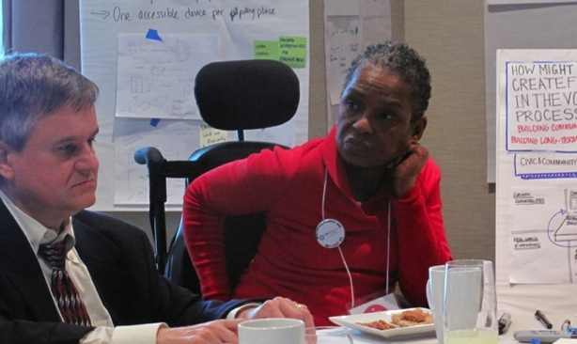
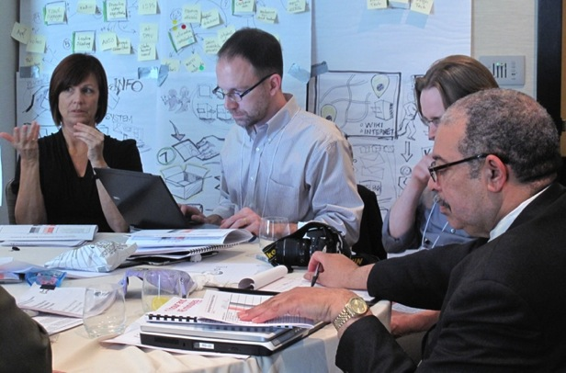
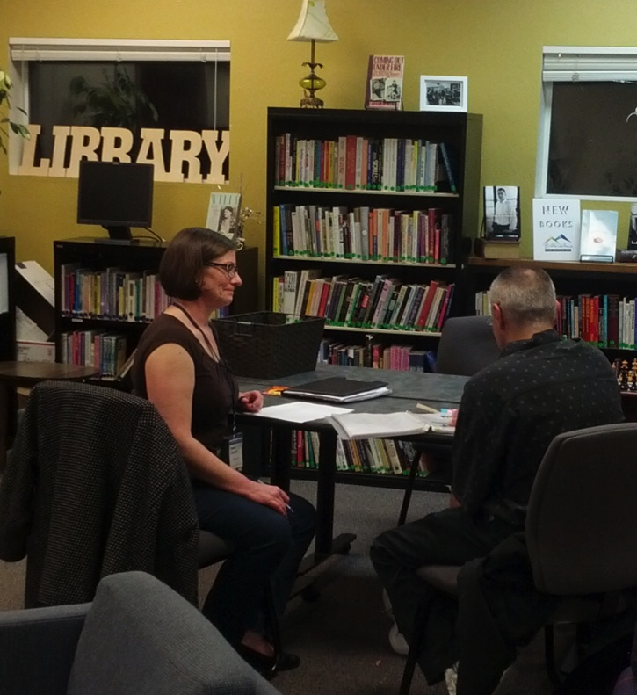
Rethink usability testing methods
Aim to learn about people not just "tasks"

Slide 27
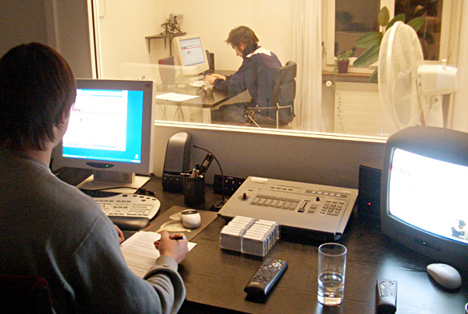
Maybe you think usability testing looks like this.
Photo: www.unic.com

Slide 28
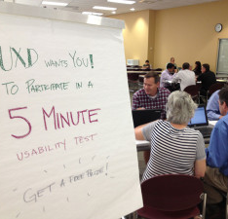
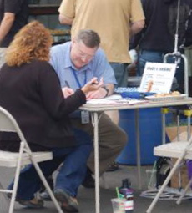
Usability testing can also look like...
Photos: UXBlog.com and Jenny Greeve

Slide 29
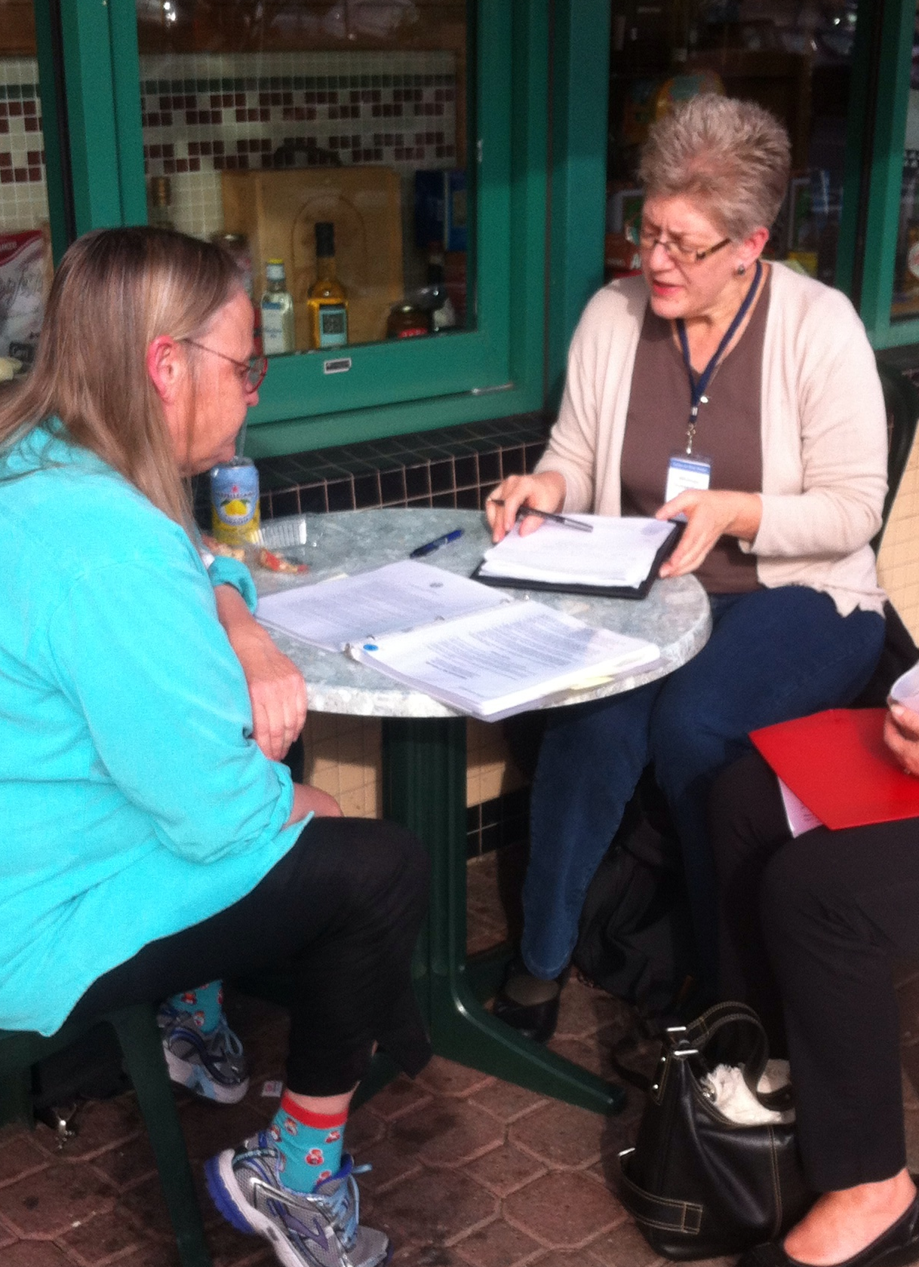
What makes it a usability test?
We observe behavior
Quietly
And use the results to inform design
Notes:
Observing behavior:
How people use the site or app
How easily they meet their goals
What causes confusion or problems
Quietly
Don't explain or demo.
Watch what they do.
Listen to their comments.
Take their problems seriously.
Use the results to inform design

Slide 30
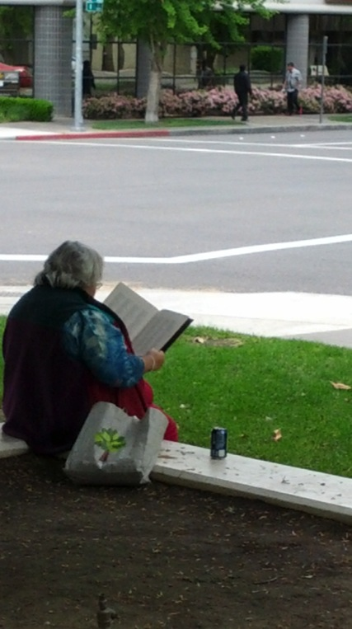
Build relationships in the community
Get to know
Community centers
Independent living centers
Organizations and associations
Schools and universities
Churches
Libraries
Adult literacy centers

Slide 31
Engage expertise in many ways
Think outside the "lab" – especially early in a project
Design studio workshops
A panel of repeat testers
Customer councils
Advisory committee
Photos: ITIF AVTI/CATEA

Slide 32
Aim for a rich view
Take time to:
Ask how they work now
Talk to participants about their experiences and preferences.
Get them to show you the products they use (or even find delightful).
Explore what features are valuable, what barriers tolerable (or not)
Go back over interactions to see why and how they worked well (or not-so-well).

Slide 33
Expand your recruiting reach
Think about where to advertise
Identify transit options in the notice
Use snowball methods
Ask for help reaching a new community
Be explicit about being inclusive

Slide 34
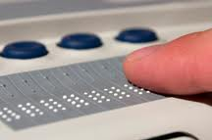
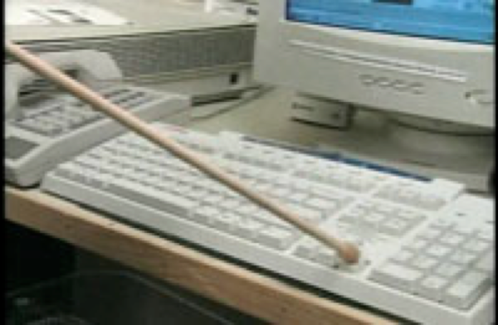
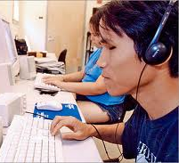
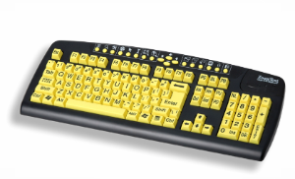
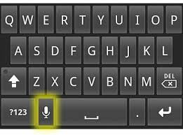
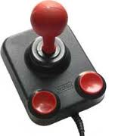
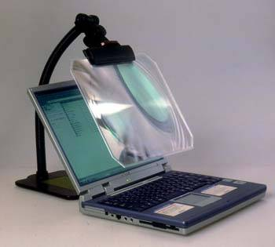
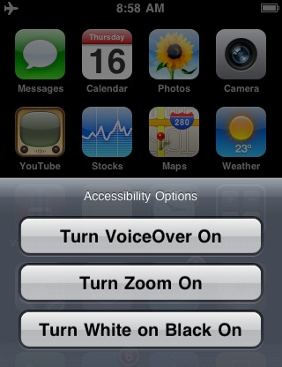
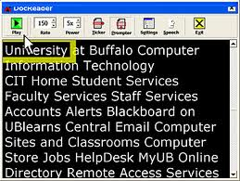
Work with your participants
Tips and tricks for successful usability sessions with diverse users
Photo: mtstcil.org

Slide 35
Think beyond the "task"
Are your research sessions flexible enough to adapt to a range of interaction styles?
Are you open to variations in how they complete tasks?
Are you flexible about the length of time for each session?
Can you adapt the session to react to unexpected barriers?

Slide 36
Getting set-up is part of the session
Watch how participants get comfortable in a new place, on a new system, or in a new situation.
Allow time for participants to get settled in the space and identify where everything is.
Make sure they are comfortable with your system or that theirs connects to the network and other technology.
Learn how they set audio volume, colors, or speech speed.

Slide 37
Be flexible about devices
Using their device
Their choice of browsers or apps
Their assistive technology and settings
How they set up their preferences
But there may be problems with a prototype
Using your device
Tested with your app, site, prototype
Control of browser and application versions
But they on a system they don't know
Small differences in settings can be disorienting

Slide 38
Include a preliminary activity
Use this time to learn more about how they use the web.
What strategies do they use with familiar and trusted sites?
What strategies do they use to explore a new site?
What cues help them assess the experience they are about to encounter?

Slide 39
Decide on the research location
At your site, look for
Availability of public transportation, parking
Friendly reception area for an assistant
Space in the room for wheelchairs or dogs
At their site, be sure to check
Reliable internet
Quiet area for the session
Know how and exactly where you will meet
Rules for use of the space

Slide 40
Consider your recording options
Check for conflicts between assistive technology and recording software.
Avoid recording on the participant's computer. It can interfere with AT the participant's interactions.
Use WebEx or GoToMeeting to display the participant's screen on a second computer and record from there.
Use an 'over-the-shoulder' camera to record the screen.

Slide 41
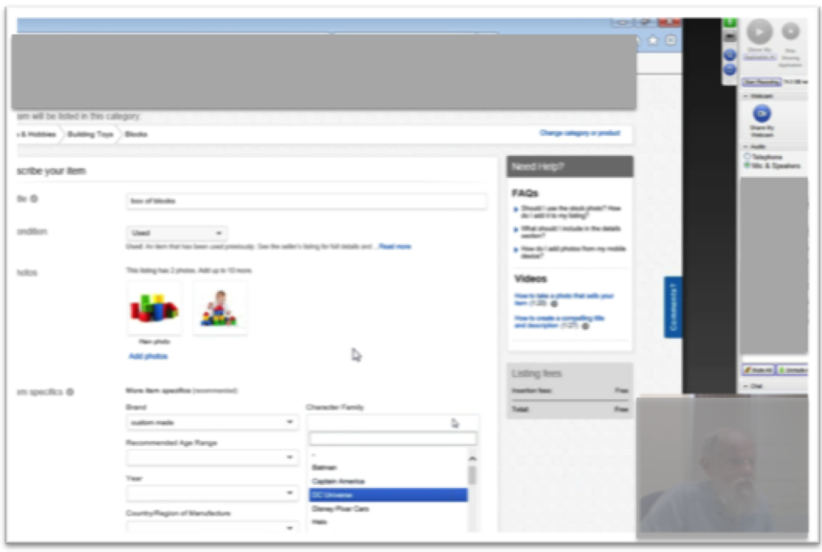
Recording setup with screen sharing
Use a tool like GoToMeeting or WebEx
Check the audio setup to avoid tech conflicts.
The participant computer connects by telephone (but doesn't dial in).
The room mic on the recording computer captures audio.
External speakers for system and screen reader audio.
This setup also allowed remote observers to watch easily.

Slide 42
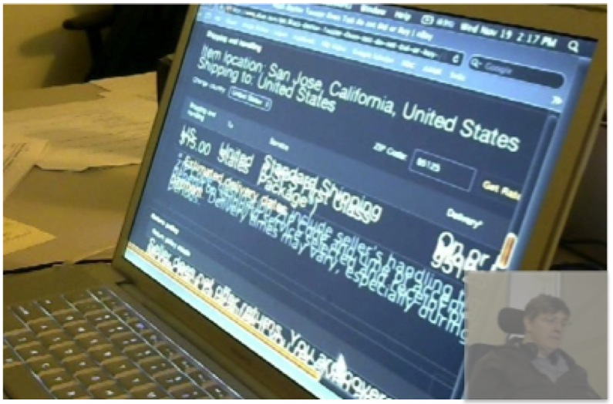
Recording setup with 2 cameras
The screen camera is on a stand just to the right of the participant.
The face camera is on a stand across the table.
External speakers for system and screen reader audio.
A mic on one computer captures the room audio.
This setup will work with Morae's usability recording software
This setup is also useful when you have a mix of devices. An adjustable stand lets you put the camera overhead to see a tablet, too.
Notes:
Morae is specialized software for recording usability sessions. It combines two video streams and audio, but also provides features like the ability to add notes to the video file for analysis.

Slide 43
Interacting with the participant
Don't distract
Give them time to get oriented on each page.
Let them tell you if they are lost or stuck.
Use small retrospectives instead of talk-aloud.
Watch and listen
How do they navigated efficiently? Solve problems? Stay oriented?
Do they have any unexpected uses for the product?
What is novel or unexpectedly delightful for them?
And all the usual rules about staying neutral.

Slide 44
Be prepared. Don't panic.
Sharing a web address or task instructions
Set up bookmarks
Have easy-to-type page with links
Send a text message
Getting past accessibility barriers
Decide in advance how (and when) you will assist with problems.
Be prepared by knowing the site well.
Know when you will abandon a task or ask them to persist.

Slide 45
Above all, be human.

Slide 46
You can...
Help usability and accessibility reunite.
Look for ways that extreme interactions styles can suggest innovation.
Look for personal adaptations that can suggest useful design tactics
Include a wide range of people, not just those who are technically adept.
Adjust your research methods to 'work with' and learn from your participants.

Slide 47



Whitney
UX research, plain language, accessibility, civic design http://civicdesign.org
AUX Personas Personas shown in the presentation are available here:http://rosenfeldmedia.com/books/a-web-for-everyone/
A Podcast for Everyone on UIE All You Can Learn, iTunes, Rosenfeld Mediahttp://rosenfeldmedia.com/books/a-web-for-everyone/#a-podcast-for-everyone
https://itunes.apple.com/us/podcast/a-podcast-for-everyone/id833646317

