Slide 1
The Legal Side of Digital Access:
Lessons from the U.S.
Lainey Feingold
Funka Accessibility Days 2016

Slide 2
Why I’m in Stockholm
2000: Negotiated 1st digital a11y agreement in U.S.
2000-2016: Negotiated 25 more
I believe in collaboration. . . .
And a strong legal foundation

Slide 3
Presentation Math
Foundation (U.S. Laws and Regulations)
+
Advocates (Who)
+
Strategies (How)
Access Wins

Slide 4

The Foundation
(U.S. Accessibility Laws)

Slide 5
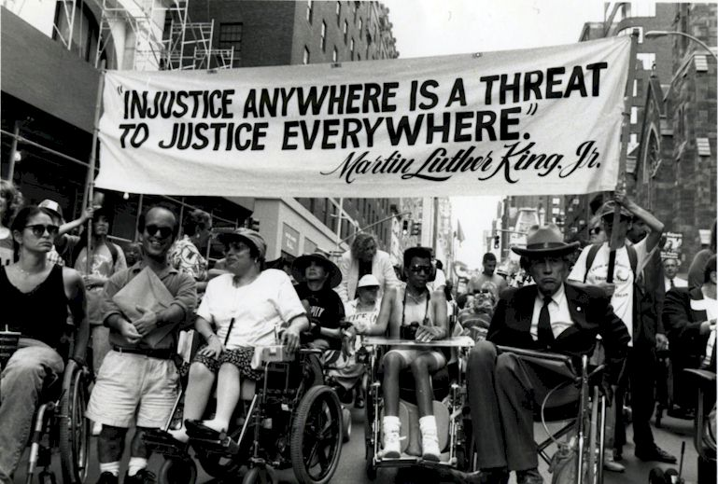
ADA is a Civil Rights Law

Slide 6
ADA is Expansive
State and Local Government
Private businesses serving public
Employment
Transportation
50 state versions!

Slide 7
ADA Web Regulations?

Slide 8

Beyond the ADA
Section 508 (Fed Gov’t Purchases)
Section 504 (Fed $$)
50 State versions
ACAA
CVAA

Slide 9
Who and How?

Slide 10
Who
US federal agencies
People who aren’t lawyers
  Disabled people
  Champions
  Developers | UX | Site Owners
People who are lawyers
  NGO | Private

Slide 11

How?

Slide 12
Structured Negotiation
Finance
Sports
Health Care
Why Does it Work?
Learn More in new book

Slide 13
Lawsuits
Education
Employment
Right to Read
Retail
Voting

Slide 14
Government Activity
Local Agencies
On-line Education
Private Organizations

Slide 15

Making Access Stick

Slide 16
Details (and more Details)
Web + mobile (and more)
WCAG 2.0 AA
Testing | Feedback
Training |Responsible Person
Meetings
Deadline
And…….

Slide 17
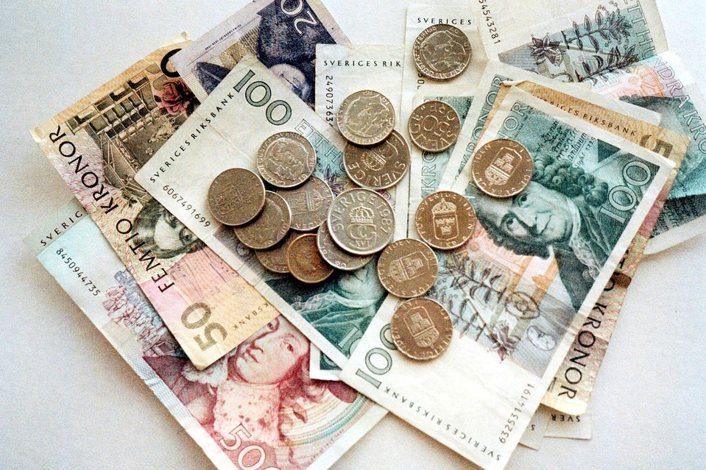

Slide 18

Without Laws….

Slide 19
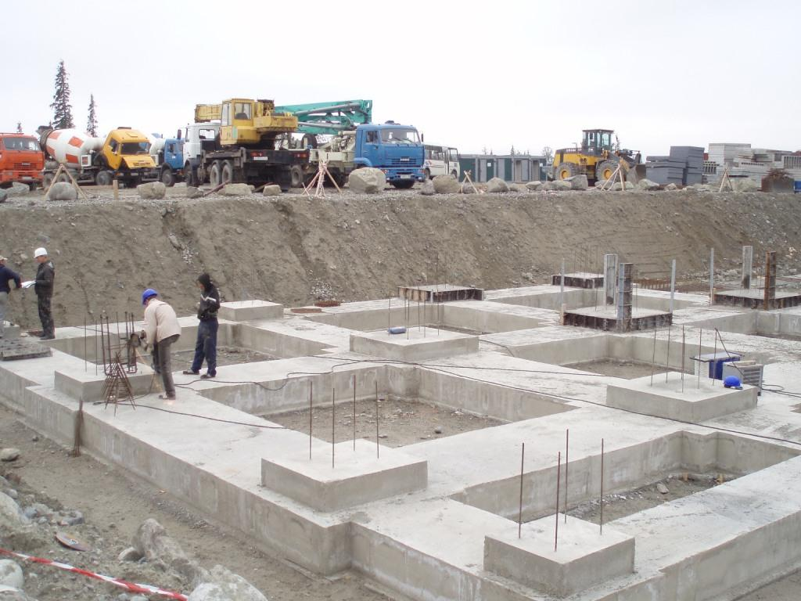
Without Advocacy….

Slide 20


Recipe for Access
+
+

Slide 21

Stay in Touch
Stay Up-to-Date
LF@LFLegal.com
Twitter: @LFLegal
LFLegal.com
Book | Fall 2016

