Slide 1
The State of Play: Accessible Gaming @ianhamilton_ // i_h@hotmail.com

Slide 2
1 Why & how 2 Hardware, platforms & middleware 3 Information 4 Games 5 Legislation

Slide 3
1 Why & how 2 Hardware, platforms & middleware 3 Information 4 Games 5 Legislation

Slide 4
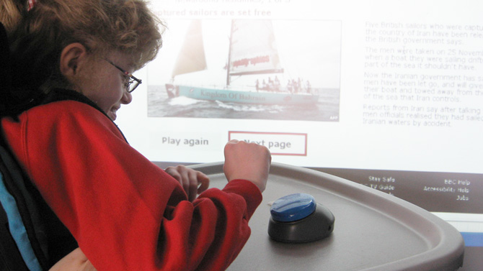

Slide 5
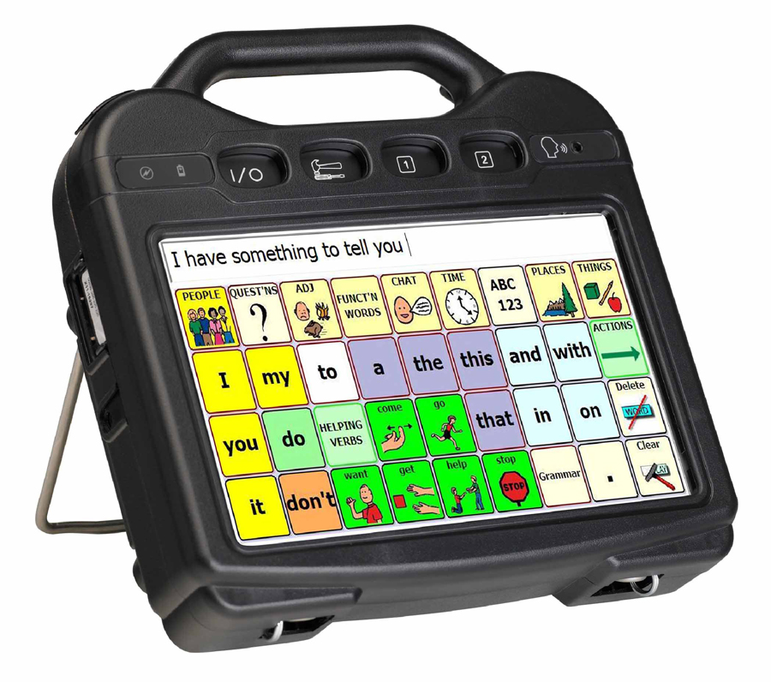

Slide 7
$140bn

Slide 8
$42bn
$140bn
$52bn
$15bn
Movies
Games
Music

Slide 10
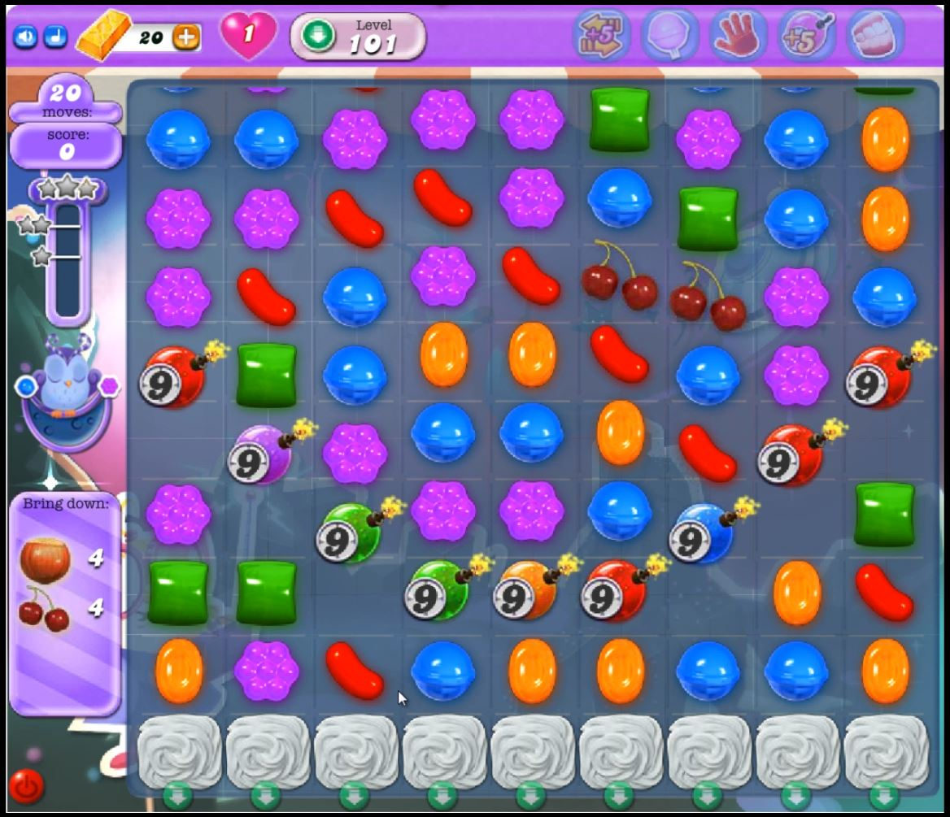

Slide 12
Game accessibility in 2018
Why games?
How accessibility in gaming varies from other industries
Recent advancements

Slide 15
1. Communicate information in more than one way 2. Allow some flexibility in how the game is played

Slide 17
Game accessibility in 2018
Why games?
How accessibility in gaming varies from other industries
Recent advancements

Slide 18
1 Why & how 2 Hardware, platforms & middleware 3 Information 4 Games 5 Legislation

Slide 19
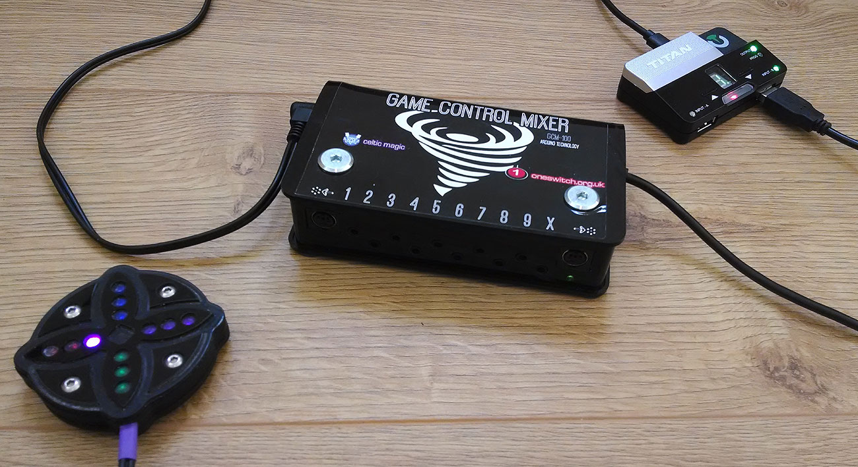

Slide 20
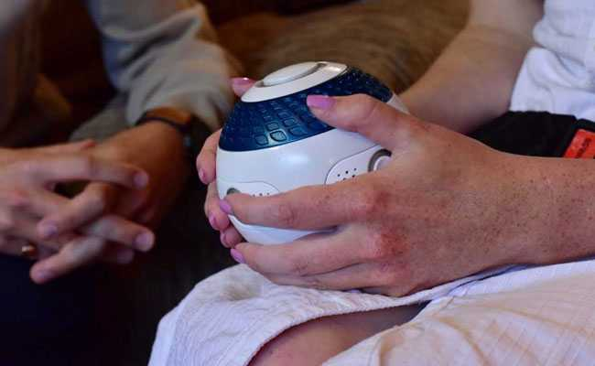

Slide 21
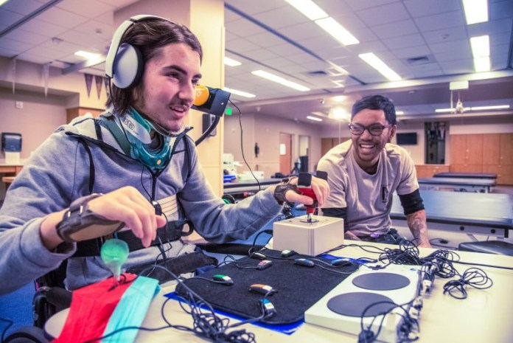

Slide 22
Sinput
sophieh.itch.io/sinput
Racing Audio Display
www.cs.columbia.edu/~brian/projects/rad.html
Accessible Realities
accessiblerealities.com/blog/tag/unreal-engine-4/
ADL engine
store.steampowered.com/app/657180/The_Adliberum_Engine_ADLENGINE/

Slide 23
1 Why & how 2 Hardware, platforms & middleware 3 Information 4 Games 5 Legislation

Slide 24
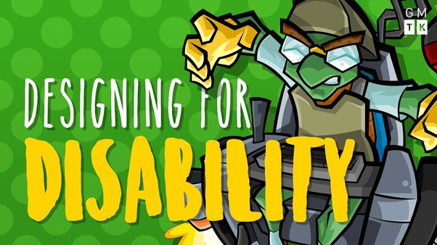

Slide 25
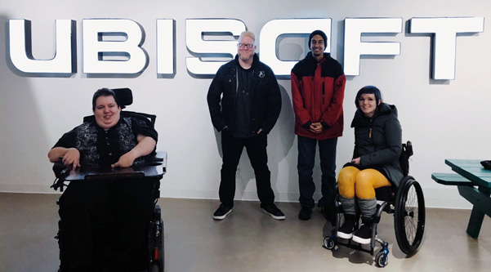

Slide 28
1 Why & how 2 Hardware, platforms & middleware 3 Information 4 Games 5 Legislation

Slide 29
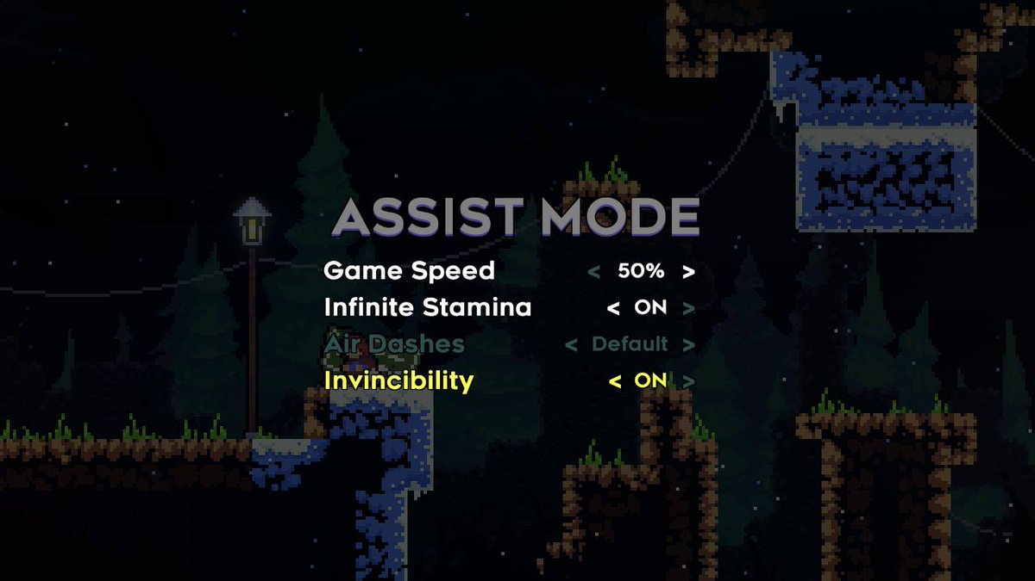

Slide 30
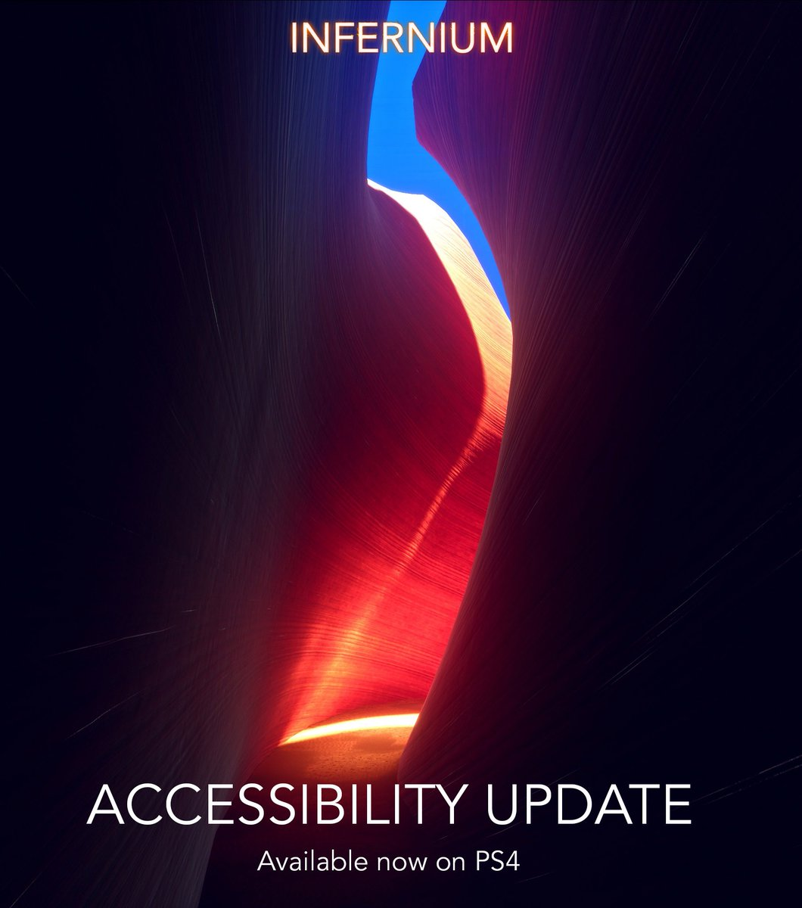
The accessibility update, now available on PS4! #Infernium
It features minor gameplay balancing, bug fixing and 4 new modes: No Enemies, Slower Enemies, More Tutorials and No "Permadeath"

Slide 31
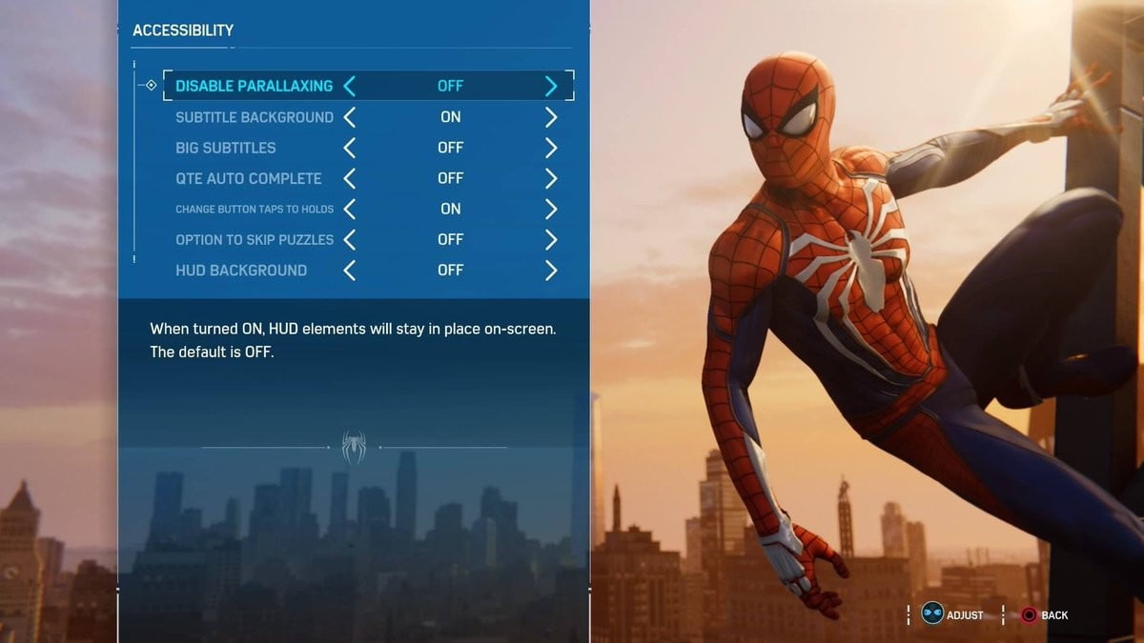

Slide 32
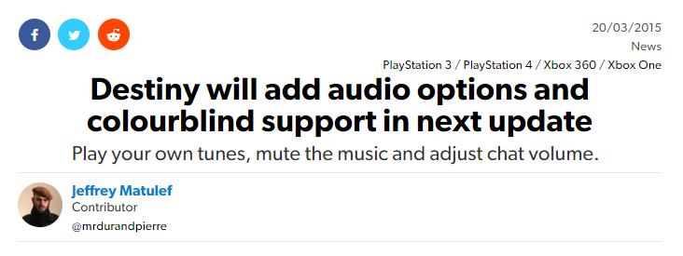

Slide 33
1 Why & how 2 Hardware, platforms & middleware 3 Information 4 Games 5 Legislation

Slide 34
So what happens next?

Slide 35
Thanks! http://tinyurl.com/2018-progress http://tinyurl.com/2018-ga-quotes Ian Hamilton @ianhamilton_ // i_h@hotmail.com

