Slide 1
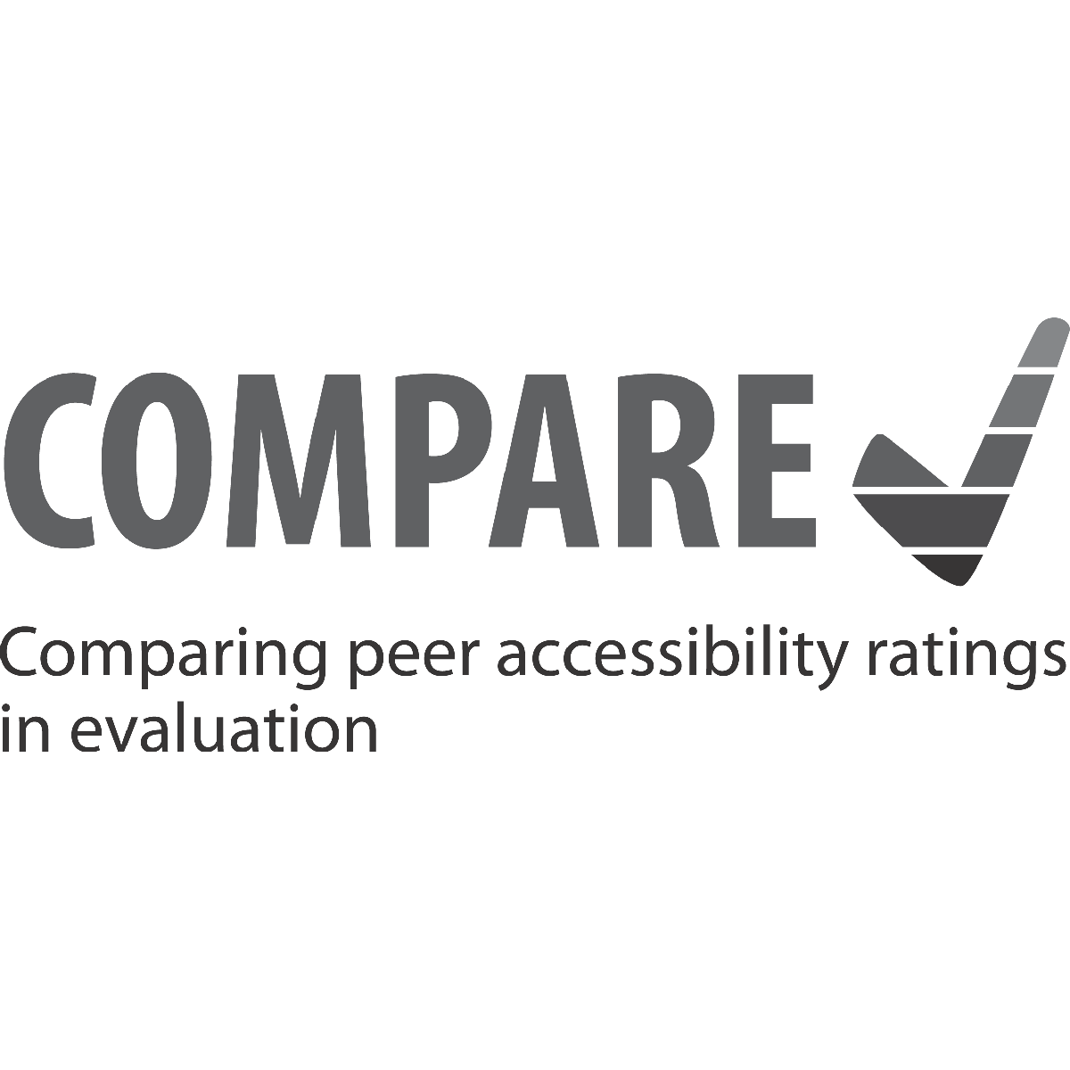
IAAP Breakfast seminar @ Funka, 10. December 2018 (Part of final COMPARE project meeting)

Slide 2
Planned structure
Some facts about the COMPARE project and results
Brief live presentation of COMPARE repository
Presentation of the Access & Use learning module
Participant questions, feedback, discussion

Slide 3
COMPARE – some facts
COMPARE has created a repository for comparing accessibility ratings between evaluators – and offers a learning resource in the Access & Use learning module
COMPARE is an Erasmus+ Strategic Partnership project between DIAS (DE), Funka (SE) and BrailleNet (FR)
People can add web content cases, add ratings and comments, or add usability tests to a Wiki-based repository
COMPARE repository: https://compare.accessiweb.org/
COMPARE Access & Use module: https://accessuse.eu/

Slide 4
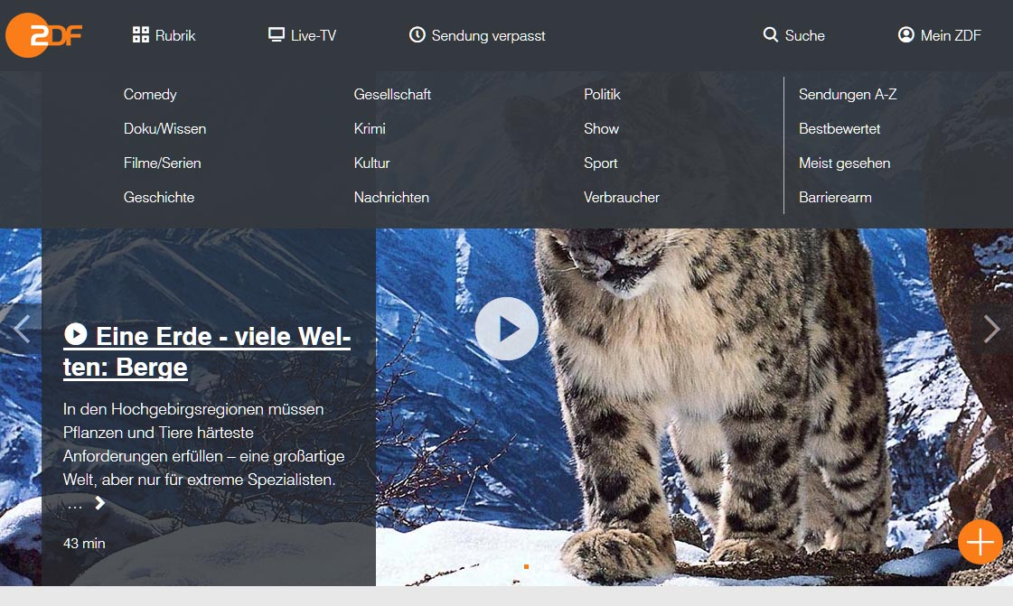
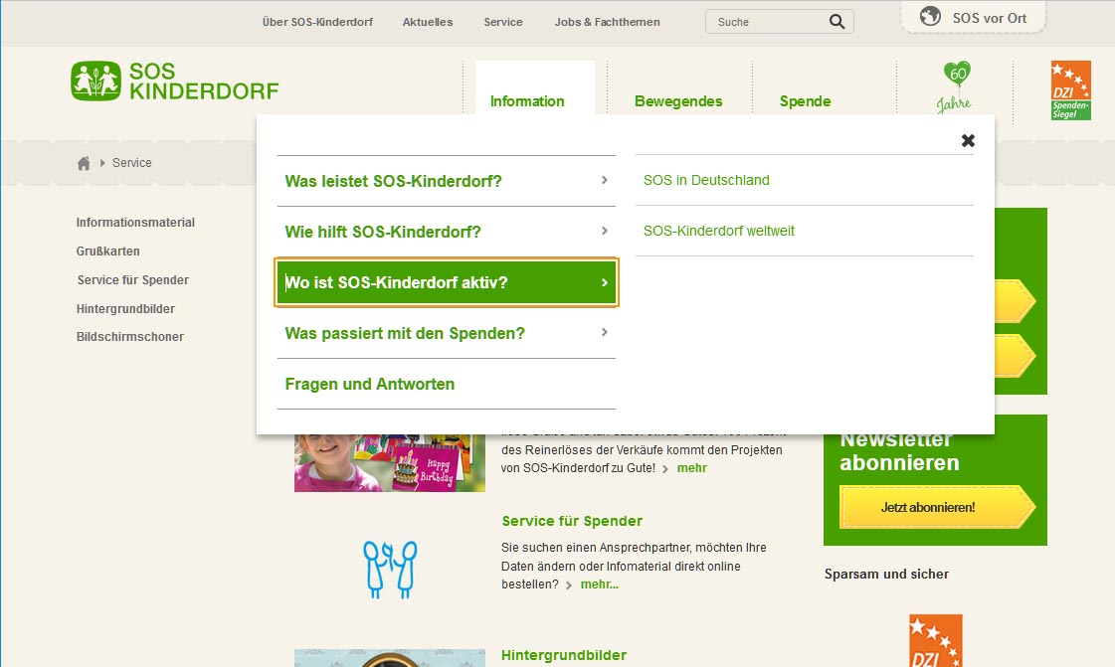
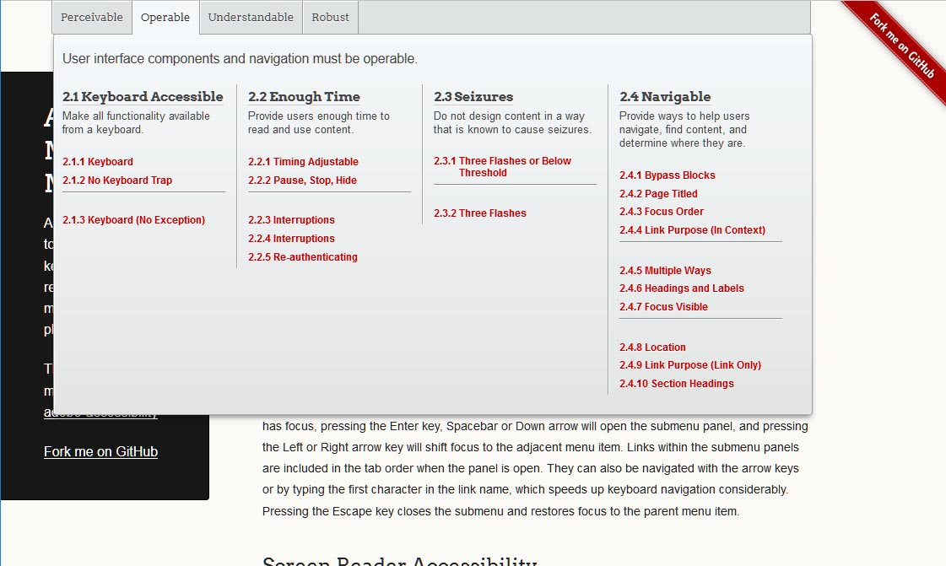
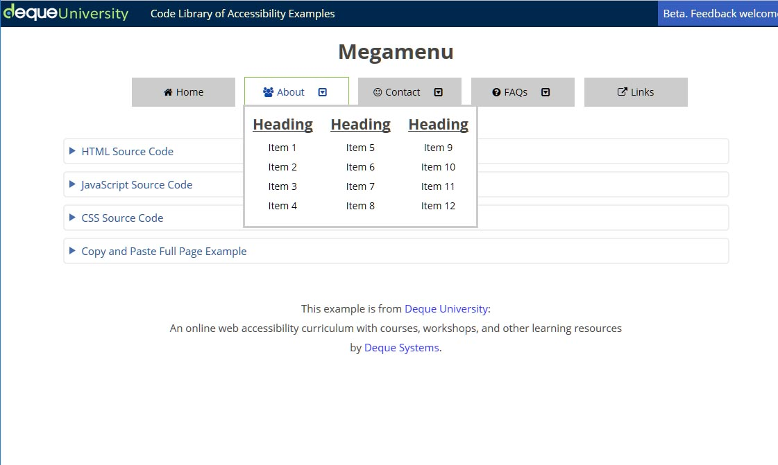
Aim: Move towards consensual assessments / ratings
Example: What are acceptable patterns for drop-down menus?

Slide 5
What happens during accessibility testing?
We use tools (toolbars, bookmarklets, code inspection via developer tools, using screen reader)
We check what others say (W3C sources, MDN, Webaim mailing list)
We discuss with peers (arbitration process in tandem tests, telcos & video conferences)
Evaluators in Europe often arrive at different results
The COMPARE idea: Create a place where evaluators and developers can document content and get feedback

Slide 6
A (self) learning module: Access & Use
Access & Use (https://accessuse.eu) aims to:
Cover important interactive components that often cause accessibility problems (e.g. dialogs, menus, tabbed interfaces)
Show problems encountered by people with disabilities (in videos)
Link to COMPARE repository
Refer to good resources / best practices

Slide 7
And now the live demo…
Detlev Fischer, DIAS GmbH E-Mail: fischer@dias.de Twitter: @wcagtest
Link to COMPARE repository:
http://compare.accessiweb.org
Link to Access & Use learning module: https://accessuse.eu

Slide 8
Some questions that we would like feedback on
Are tests with users in the videos instructive / in the right format?
Is a resource like this suitable for different audiences? If not, what would be better?
Is the Access & Use format suitable for learning about the issues? Would it be helpful to have quiz-type checks? More technical details? Anything else?

